Slide 1


PROSTATE CANCER TRAINING MODULE SECTION II: PROSTATE CANCER TREATMENT
1 | For internal training purpose only.
Notes:
Welcome to the Prostate Cancer Training Module. This module is divided into 5 sub-sections. The first sub-section will detail treatment continuum and treatment guidelines. The second sub-section will present information on the role of nomograms in treatment decision-making. The third sub-section will tackle prostate cancer treatment options. The forth sub-section will discuss prostate cancer disease staging including risk stratification followed by a final summary section.

Slide 2
Disclaimer
These training slides must be approved by your local medical and regulatory departments in accordance with your country-specific laws and regulations.
These slides are meant for internal training purpose only.
Notes:
Disclaimer
These training slides must be approved by your local medical and regulatory departments in accordance with your country-specific laws and regulations. These slides are meant for internal training purpose only.

Slide 3
List of Contents
Topics | Slide nos.
Role of nomograms in treatment decisions | 5-12
Prostate cancer treatment Active surveillance and watchful waiting Surgery Radiation therapy Androgen deprivation therapy (ADT) Chemotherapy Bone-directed treatments Immunotherapy Experimental therapeutic options Latest advanced therapies | 13-48
Prostate cancer staging and risk stratification | 49-54
Treatment continuum and treatment guidelines | 55-75
Summary | 76-79

Slide 4



Learning Objectives
Explain the use of nomograms in treatment decisions
Provide an overview of the treatment options for prostate cancer
Describe each treatment option including its mechanism of action and associated side effects
List the new advances in the treatment of prostate cancer
Describe in detail the guidelines for the treatment of prostate cancer
Notes:
Learning objectives
Welcome to the Prostate Cancer Module. This module is divided into 5 sub-sections. This second section will present an overview of the treatment options for prostate cancer and describe guidelines for the treatment of the disease.
At the end of this section, you should be able to:
Explain the use of nomograms in treatment decisions
Provide an overview of the treatment options for prostate cancer
Describe each treatment option including its mechanism of action and associated side effects
List the new advances in the treatment of prostate cancer
Describe in detail the guidelines for the treatment of prostate cancer

Slide 5
Role of Nomograms in Treatment Decisions

Slide 6
Prognostic Models and Nomograms
1/7
Nomograms
Are one of the most accurate tools currently available
Describe various statistical methodologies that can be used to predict a particular disease outcome¹
Incorporate both continuous and categorical variables¹
Show the effect of the variables on the outcome represented by the axes¹
Attribute the risk points depending on the prognostic significance of the variable of interest¹
Uses of nomograms
Nomograms can assist physicians and patients in making treatment decisions.¹
Nomograms can be used at each stage of the disease pathway to assist in making a prediction based on the clinical parameters of a patient, rather than a risk group.¹
Shariat SF, et al. Future Oncol. 2009;5(10):1555-1584.
Notes:
Prognostic models and nomograms
Nomograms are one of the most accurate predictive tools.¹ /p5/para4 Nomogram is the term used to describe various statistical methodologies that can be used to predict a particular disease outcome. The nomogram incorporates continuous or categorical variables, and the effect of these on the outcome of interest is represented by the axes. Risk points are attributed depending on the prognostic significance of the variable of interest.¹ /p5/para1
Nomograms can assist both physicians and patients in taking treatment decisions.¹ /p5/para4, /p10/para4-5 Nomogram can be used at each stage of the disease pathway to assist the clinician to make a tailored prediction based on the clinical parameters of an individual patient rather than a risk group.
Reference:
Shariat SF, Kattan MW, Vickers AJ, Karakiewicz PI, Scardino PT. Critical review of prostate cancer predictive tools. Future Oncol. 2009;5(10):1555-1584. doi:10.2217/fon.09.121.

Slide 7
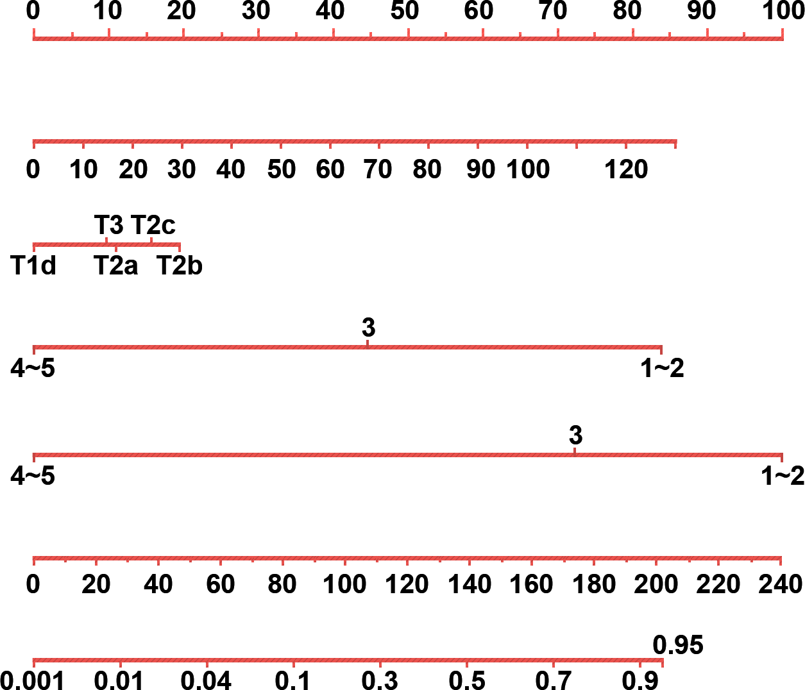
Prognostic Models and Nomograms (cont.)
2/7
Sample nomogram¹
Points
Locate the patient’s value for each predictor variable on the nomogram scale and assign a point value to each variable.²
Point values are added to obtain a total point value.²
Total point value is plotted on the total point axis to estimate the combined effect of all predictors on the probability of a particular outcome (e.g., biochemical recurrence).²
Preoperative PSA
Clinical stage
BX Gleason pri
BX Gleason sec
Total points
P(upgrade)
BX Gleason pri, primary biopsy Gleason score; BX Gleason sec, secondary biopsy Gleason score; PSA, prostate-specific antigen; P(upgrade), probability of biopsy Gleason sum upgrading.
Adapted from Chun, 2006¹
Chun FK-H, et al. Eur Urol. 2006;50(5):914-926.
Shariat SF, et al. Future Oncol. 2009;5(10):1555-1584.
Notes:
Prognostic models and nomograms (cont.)
A nomogram is used by locating the patient’s value for each predictor variable on its scale. Point values for each variable are then added to obtain a total point value. This value is plotted on the total point axis, which is used to estimate the combined effect of all predictors on the probability of biochemical recurrence.^{1,2} /p5/para1,4, /p10/para4-5, /p915/col1/Fig1
References:
Chun FK-H, Karakiewicz PI, Briganti A, et al. Prostate cancer nomograms: an update. Eur Urol. 2006;50(5):914-926. doi:10.1016/j.eururo.2006.07.042.
Shariat SF, Kattan MW, Vickers AJ, Karakiewicz PI, Scardino PT. Critical review of prostate cancer predictive tools. Future Oncol. 2009;5(10):1555-1584. doi:10.2217/fon.09.121.

Slide 8
Prognostic Models and Nomograms (cont.)
3/7
Types of nomograms and examples of predictors used¹
.
Serial
no.
Type of nomogram
Examples of predictors/variables
1.
To predict positive outcome of initial biopsy nomogram
Age, race, family history, DRE, PSA
To predict positive outcome of repeat biopsy nomogram
Age, DRE, negative cores, history of HGPIN, ASAP, family history
2
3
To predict pathologic features of clinically localised prostate cancer
PSA, primary and secondary biopsy Gleason score, TRUS volume, clinical stage
4
To predict biochemical recurrence after radical prostatectomy
PSA, clinical stage, biopsy Gleason sum, number of positive and negative biopsy cores, ECE, SVI, LNI
ASAP, atypical small acinar proliferation of prostate; DRE, digital rectal exam; ECE, extracapsular extension; HGPIN, high-grade intraepithelial neoplasia; LNI, lymph node invasion; PSA, prostate-specific antigen; SVI, seminal vesicle invasion; TRUS, transrectal ultrasound.
Adapted from Chun, 2006¹
Chun FK-H, et al. Eur Urol. 2006;50(5):914-926.
Notes:
Prognostic models and nomograms (cont.)
Several predictive nomograms have been developed.¹ /918/Table1-2, /p919/Table4, /p920/Table5, /p921/Table6, /922/Table7-8, /p924/Table9-10 The table lists various kinds of nomograms along with examples of variables used to predict the outcome. For instance, preoperative nomograms include clinical stage, prostate-specific antigen (PSA) levels, Gleason score and the number of positive and negative prostate biopsy cores as variables, while postoperative nomograms additionally include pathologic findings (e.g., extracapsular extension or seminal vesicle invasion and lymph node involvement).¹ /918/Table1-2, /p919/Table4, /p920/Table5, /p921/Table6, /922/Table7-8, /p924/Table9-10
Reference:
Chun FK-H, Karakiewicz PI, Briganti A, et al. Prostate cancer nomograms: an update. Eur Urol. 2006;50(5):914-926. doi:10.1016/j.eururo.2006.07.042.

Slide 9
Prognostic Models and Nomograms (cont.)
4/7
Types of nomograms and examples of predictors used¹ (cont.)
.
Serial
no.
Type of nomogram
Examples of predictors/variables
5.
To predict biochemical recurrence after radiation therapy
PSA, biopsy Gleason sum, clinical stage, delivery of hormone therapy (yes or no)
To predict metastatic progression after 3-D conformal radiation therapy
PSA, clinical stage, biopsy Gleason sum
6
Age, Charlson performance index, presence of angina, systolic blood pressure, smoking, PSA, Gleason sum, type of treatment
7
To predict life expectancy
8
To predict survival (androgen-independent)
PSA at ADT initiation, PSA DT, nadir PSA on ADT, time from ADT to AIPCa diagnosis
ADT, androgen deprivation therapy; AIPCa, androgen-independent prostate cancer; ECE, extracapsular extension; PSA, prostate-specific antigen; PSA DT, PSA doubling time.
Adapted from Chun, 2006¹
Chun FK-H, et al. Eur Urol. 2006;50(5):914-926.
Notes:
Prognostic models and nomograms (cont.)
Examples of nomograms for predicting biochemical recurrence following radiation therapy include PSA level, prostate biopsy, Gleason score, clinical stage and the status of delivery of hormone therapy to the patient. Likewise, nomograms for predicting life expectancy include age, Charlson performance index, presence of angina, systolic blood pressure, smoking, PSA level, Gleason sum and the type of treatment given to the patient.¹ 918/Table1-2, /p919/Table4, /p920/Table5, /p921/Table6, /922/Table7-8, /p924/Table9-10
Reference:
Chun FK-H, Karakiewicz PI, Briganti A, et al. Prostate cancer nomograms: an update. Eur Urol. 2006;50(5):914-926. doi:10.1016/j.eururo.2006.07.042.

Slide 10
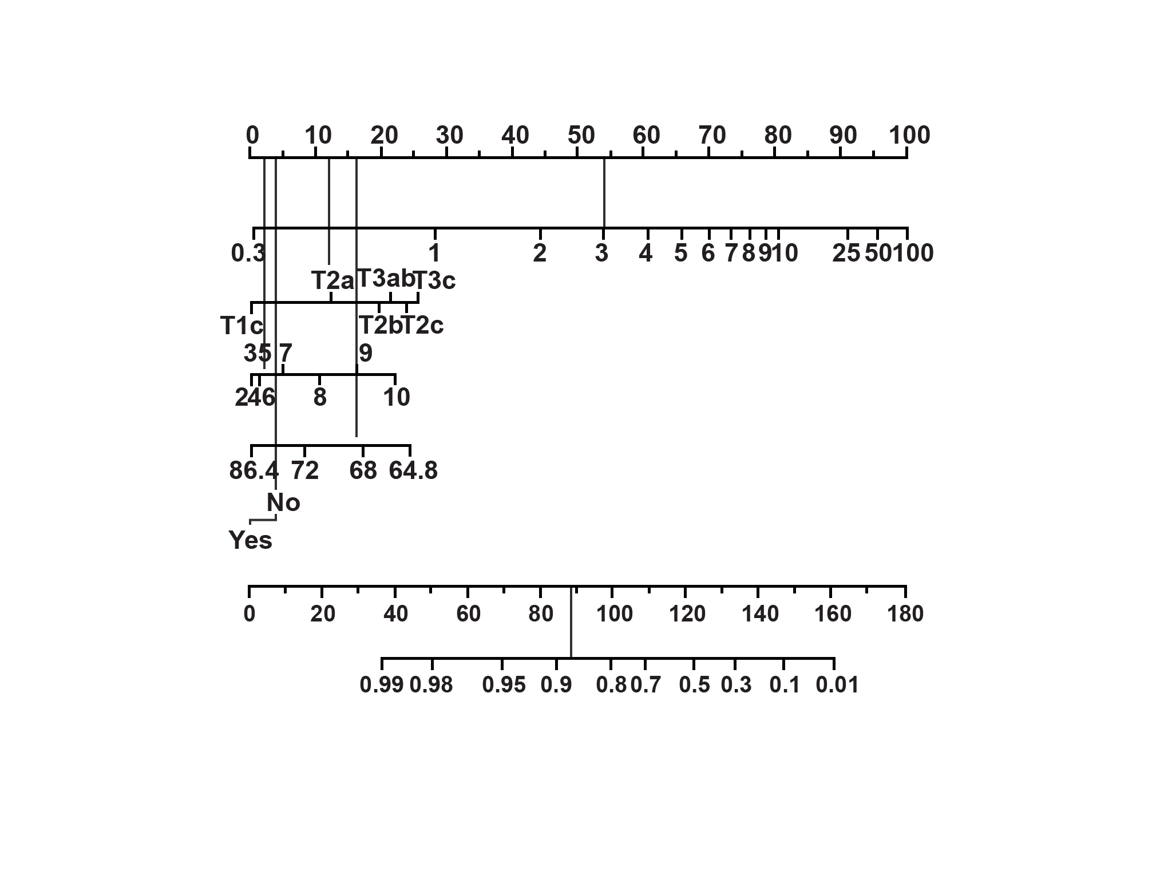
Prognostic Models and Nomograms (cont.)
5/7
Pretreatment nomogram for predicting the 5-year biochemical recurrence-free probability after 3D conformal external beam radiotherapy¹
This nomogram is used as a pretreatment tool to predict the 5-year biochemical recurrence-free probability after 3-dimensional conformal external beam radiotherapy.¹
The predictor variables include PSA, biopsy Gleason sum, clinical stage, neoadjuvant androgen deprivation therapy (ADT) and radiation dose delivered.¹
Points
Pretreatment PSA
Clinical stage
Bx Gleason sum
Dose (Gy)
Hormones
Total points
60-month recurrence-free probability
5-year biochemical recurrence-free probability is 0.87
Bx, primary biopsy; PSA, prostate-specific antigen.
Adapted from Shariat, 2009¹
Shariat SF, et al. Future Oncol. 2009;5(10):1555-1584.
Notes:
Prognostic models and nomograms (cont.)
This next two slide shows examples of two kinds of nomograms. The first nomogram is used as a pretreatment prediction tool to predict the 5-year biochemical recurrence-free probability after 3-dimensional conformal external beam radiotherapy. This tool was internally validated in 1042 patients and the variables include PSA, biopsy Gleason sum, clinical stage, neoadjuvant androgen deprivation therapy (ADT) and radiation dose delivered.¹ /p5/para1, /p7/para4, /p44/Table5, /p27/Fig4
Reference:
Shariat SF, Kattan MW, Vickers AJ, Karakiewicz PI, Scardino PT. Critical review of prostate cancer predictive tools. Future Oncol. 2009;5(10):1555-1584. doi:10.2217/fon.09.121.

Slide 11
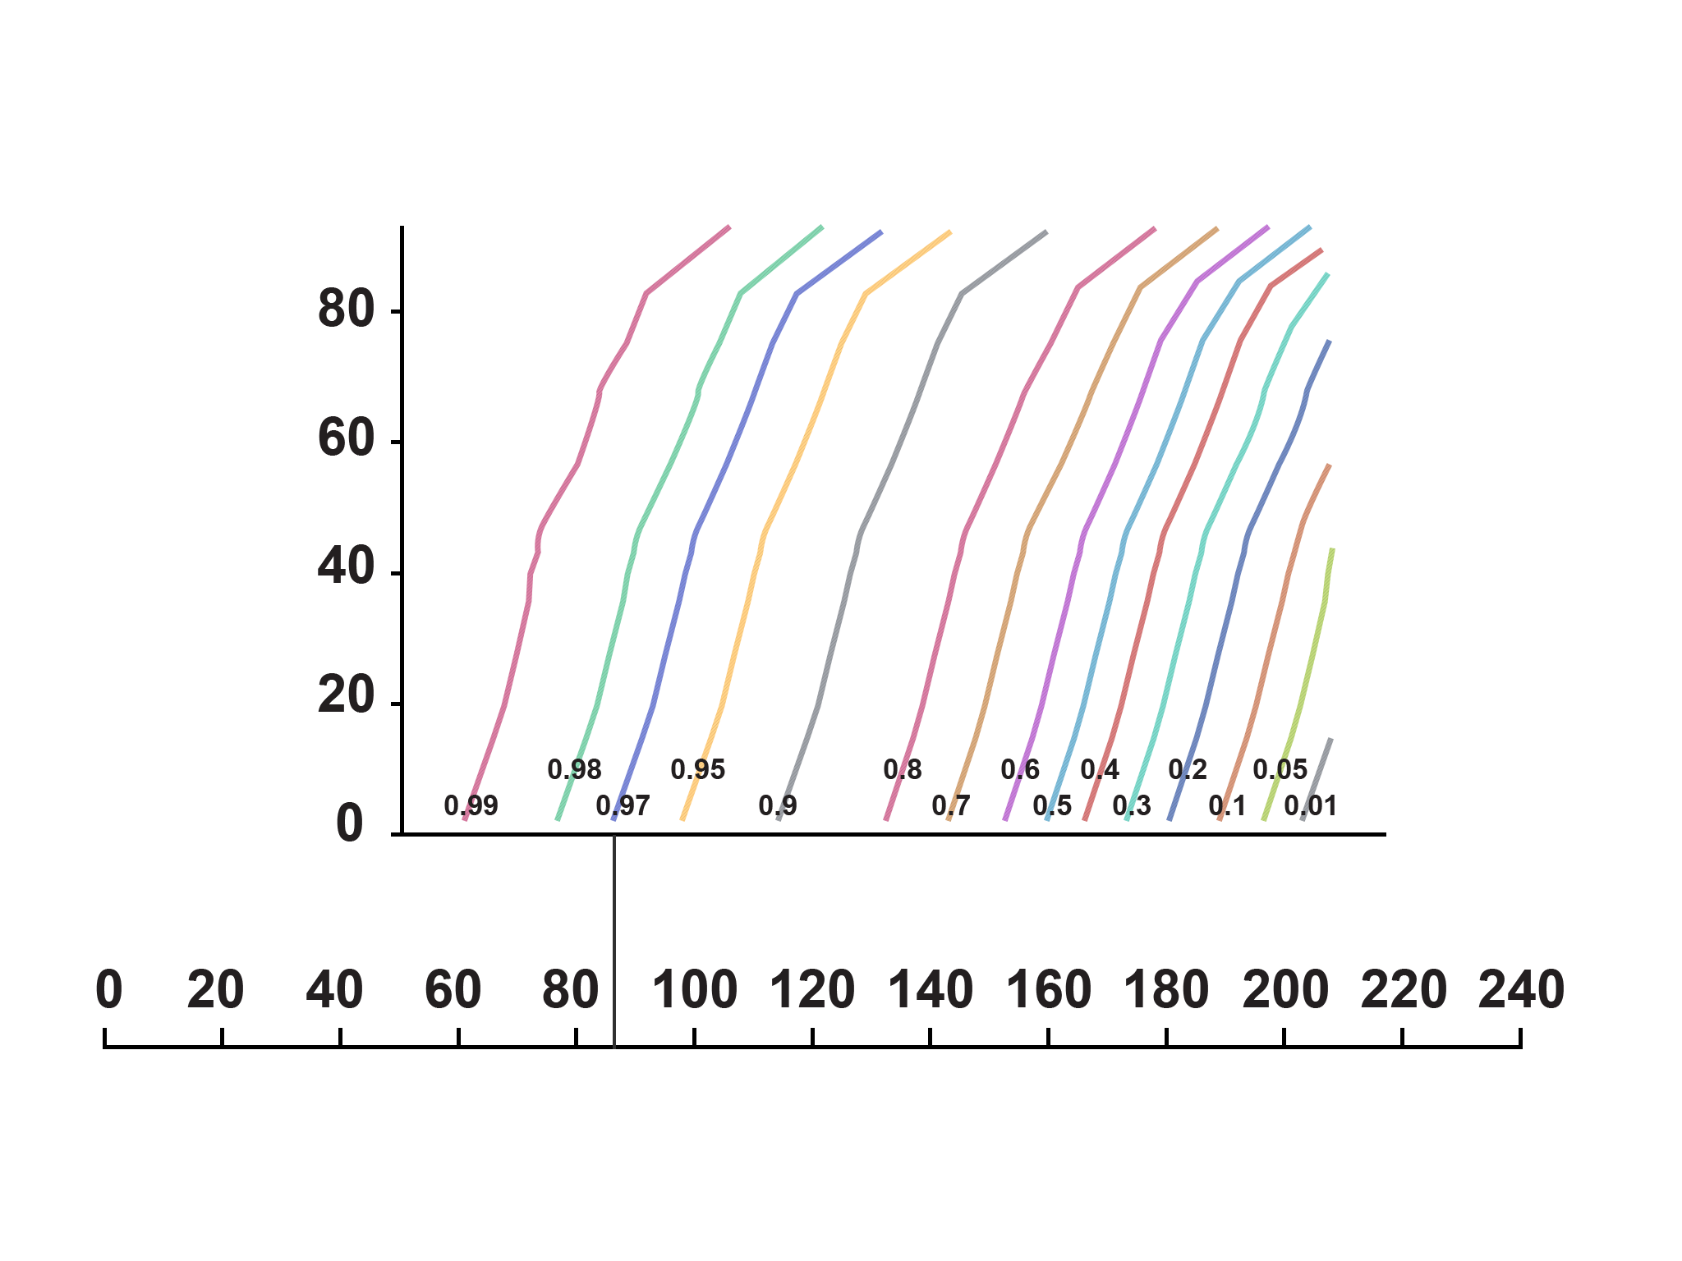
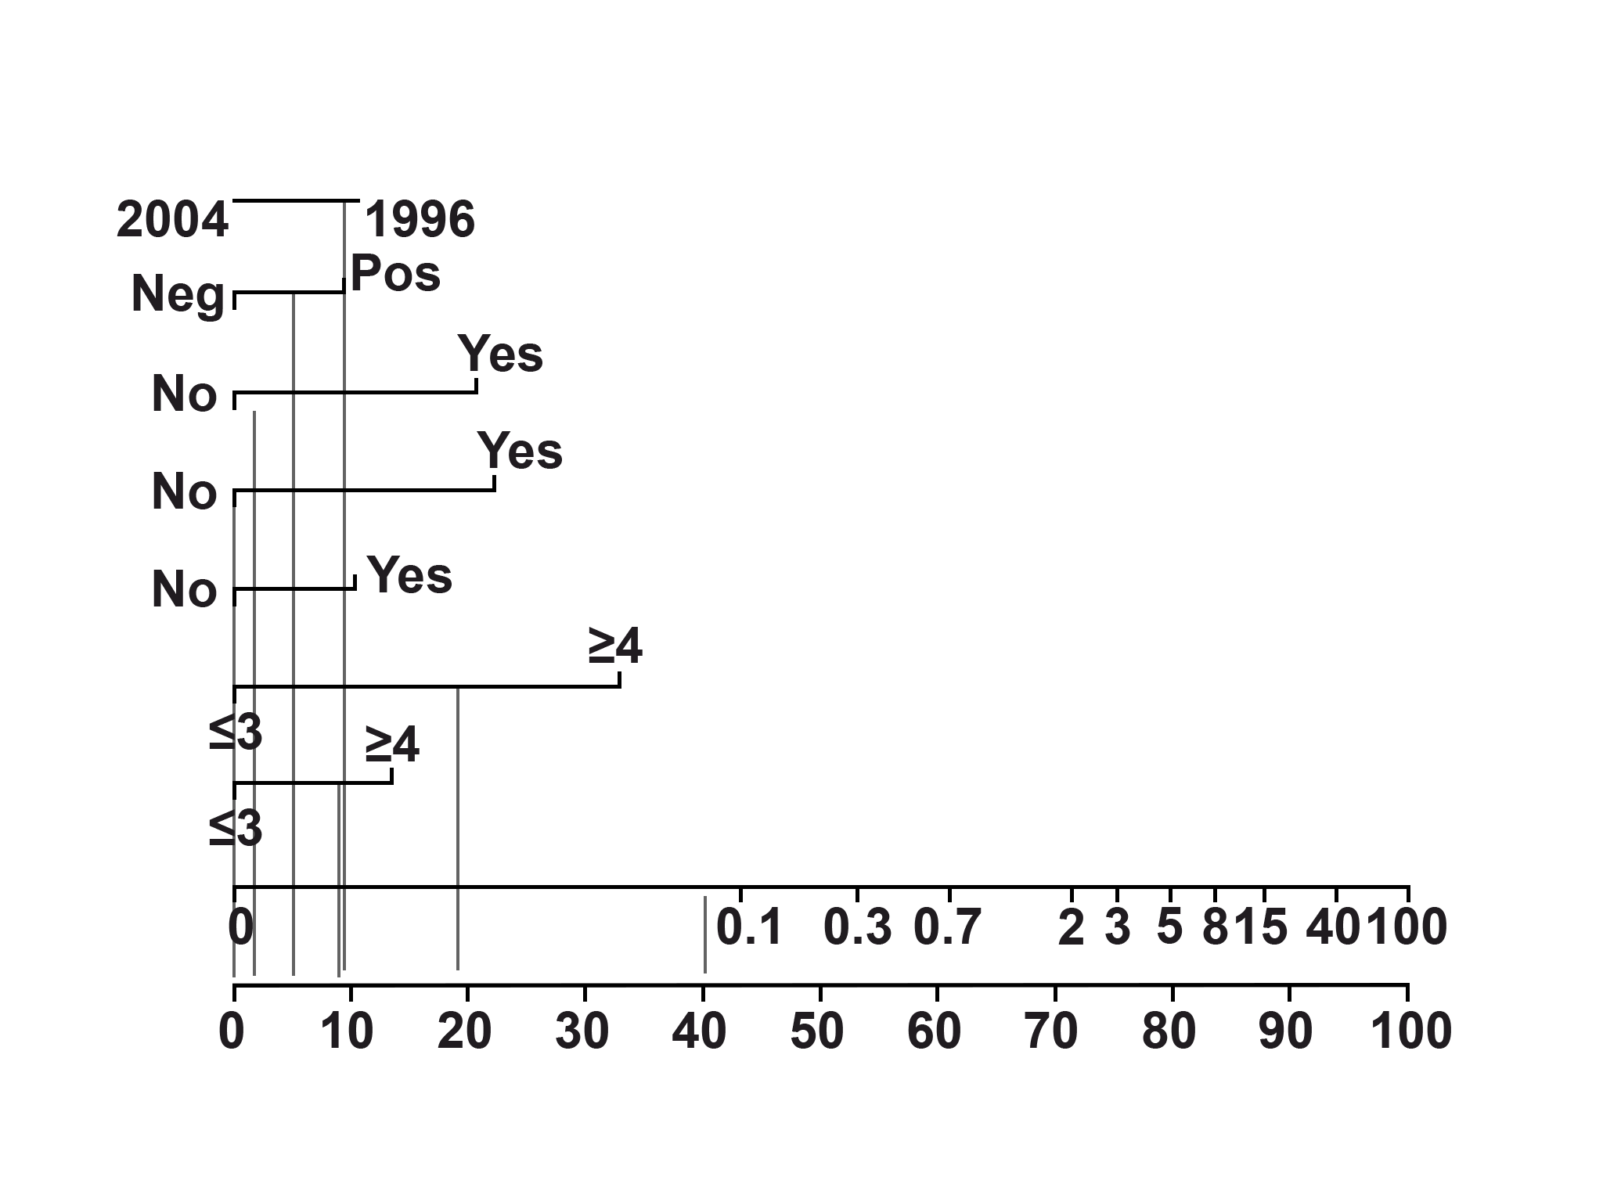
Prognostic Models and Nomograms (cont.)
6/7
Postoperative nomogram predicting the 10-year biochemical recurrence-free probability after radical prostatectomy¹
This nomogram is used as postoperative tool to predict 10-year biochemical recurrence-free probability following radical prostatectomy.¹
The predictor variables include extracapsular extension, seminal vesicle invasion and lymph node invasion as predictive variables.¹
Months disease-free after radical prostatectomy
Total points
Year of radical prostatectomy
Surgical margins
Extracapsular extension
Seminal vesicle invasion
Lymph node invasion
Primary Gleason
Secondary Gleason
Preoperative PSA
Points
Shariat SF, et al. Future Oncol. 2009;5(10):1555-1584.
Adapted from Shariat, 2009¹
Notes:
Prognostic models and nomograms (cont.)
The second nomogram is a postoperative tool that can be used to predict 10-year biochemical recurrence-free probability following radical prostatectomy. This nomogram was developed using extracapsular extension, seminal vesicle invasion and lymph node invasion as predictive variables. Beginning with locating the patient’s surgical margin status, the physician has to draw a straight line down to the points axis. This process is repeated for each variable and then the total number of points are calculated. This point is located on the total points axis and then a straight line is drawn to the months disease-free after radical prostatectomy axis. The 10-year progression-free probability from the time of radical prostatectomy is calculated using a slanted vertical line that crosses this intersection point.¹ /p7/para3, /p26/Fig3
Reference:
Shariat SF, Kattan MW, Vickers AJ, Karakiewicz PI, Scardino PT. Critical review of prostate cancer predictive tools. Future Oncol. 2009;5(10):1555-1584. doi:10.2217/fon.09.121.

Slide 12


Knowledge Check (1)
7/7
Which of the following variables can be used to predict the biochemical recurrence probability after radical prostatectomy?
PSA
Lymph node invasion
Smoking
Extracapsular extension
Genetics
PSA
Lymph node invasion
Extracapsular extension
PSA, prostate-specific antigen.
Notes:
Knowledge check (1)
Which of the following variables can be used to predict the biochemical recurrence probability after radical prostatectomy?
PSA
Lymph node invasion
Smoking
Extracapsular extension
Genetics
Answer: 1, 2 and 4. PSA, lymph node invasion and extracapsular extension are typically used to predict the biochemical recurrence probability after radical prostatectomy.
PSA, prostate-specific antigen.

Slide 13
Prostate Cancer Treatment

Slide 14

Prostate Cancer Treatment Options
1/35
Active surveillance and watchful waiting¹
Surgery¹
Radiation therapy¹
Androgen deprivation therapy (ADT)¹
Monotherapy
Combination therapy
Chemotherapy¹
Bone-directed treatments¹
Immunotherapy¹
Experimental therapeutic options
High-intensity focussed ultrasound (HIFU)¹
Cryosurgery¹
Latest advanced therapies
http://www.cancer.org/acs/groups/cid/documents/webcontent/003134-pdf.pdf. Accessed April 4, 2016.
Notes:
Prostate cancer treatment options
There are many options available for treating prostate cancer. Depending on the stage of the disease, the treatment options may include active surveillance, watchful waiting, surgery, radiation therapy, ADT, chemotherapy, bone-directed treatments, immunotherapy and experimental therapeutic options like cryosurgery and high-intensity focussed ultrasound (HIFU). These options may be used individually or in combination.¹ /p28/para5, /p29/para1, /p80/para5 Cryosurgery utilises cold temperature to freeze and destroy cancer cells.¹ /p46/para9 On the other hand, HIFU destroys the cancer cells by using the heat generated by highly focussed ultrasonic waves.¹ /p80/para5 Bone-directed treatments address pain associated with prostate cancer that has metastasised to the bones.¹ /p83/para1
In the next slide, we will discuss about watchful waiting and active surveillance in detail.
Reference:
Prostate cancer. American Cancer Society Web site. http://www.cancer.org/acs/groups/cid/documents/webcontent/003134-pdf.pdf. Accessed April 4, 2016.

Slide 15
Active Surveillance and Watchful Waiting
Differences between active surveillance and watchful waiting¹
2/35
Parameter
Active surveillance
Watchful waiting
Treatment intent
Curative
Palliative
Follow-up
Predefined schedule
Patient-specific
Assessment/markers
used
DRE, PSA, re-biopsy and optional MRI
Not predefined
Life expectancy
> 10 years
< 10 years
Aim
Minimise treatment-related toxicity
without compromising survival
Minimise treatment-related
toxicity
Comments
Only for a subgroup of
low-risk patients
Can apply to patients
at all stages
DRE, digital rectal exam; MRI, magnetic resonance imaging; PSA, prostate-specific antigen.
Adapted from Mottet, 2015¹
Key message
Results from the Scandinavian prostate cancer group study number 4 demonstrated that a large proportion of long-term survivors in the watchful-waiting group did not have disease progression and did not require palliative treatment.²
http://uroweb.org/wp-content/uploads/09-Prostate-Cancer_LR.pdf. Accessed April 8, 2016.
Bill-Axelson A, et al. N Engl J Med. 2014;370(10):932-942.
Notes:
Active surveillance and watchful waiting
Conservative management strategies include active surveillance and watchful waiting. The aim of active surveillance is to ensure correct timing for curative treatment, prompted by predefined thresholds of potentially life-threatening disease.¹ /p30/para5-6 Watchful waiting on the other hand refers to conservative management until the development of local or systemic progression of disease-related complaints.¹ /p31/para1 The table outlines the differences between the 2 approaches.¹ /p31/Table6.1.1
The prostate cancer intervention versus observation trial did not show any difference in the 10-year survival between watchful waiting and radical prostatectomy in patients with localised prostate cancer and PSA less than 10 ng/mL.¹ /p31/para2 The results from the Scandinavian prostate cancer group study number 4 trial showed that a substantial proportion of long-term survivors in the watchful waiting group did not require palliative treatment and did not have disease progression.² /p932/para2, /p941/col2/para1 Results from the prostate testing for cancer and treatment randomised trial, the largest trial conducted so far, designed to assess the effectiveness and cost-effectiveness of active surveillance, external beam conformal radiotherapy with neoadjuvant androgen suppression and radical prostatectomy, are expected in 2016.³ /p1110/col1/para2, /p1117/col1/para2
In the next slide, we will discuss about surgical methods.
References:
Mottet N, Bellmunt J, Briers E, et al. Guidelines on prostate cancer. European Association of Urology Web site. http://uroweb.org/wp-content/uploads/09-Prostate-Cancer_LR.pdf. Accessed April 8, 2016.
Bill-Axelson A, Holmberg L, Garmo H, et al. Radical prostatectomy or watchful waiting in early prostate cancer. N Engl J Med. 2014;370(10):932-942. doi:10.1056/NEJMoa1311593.
Lane JA, Donovan JL, Davis M, et al. Active monitoring, radical prostatectomy, or radiotherapy for localised prostate cancer: study design and diagnostic and baseline results of the ProtecT randomised phase 3 trial. Lancet Oncol. 2014;15(10):1109-1118. doi:10.1016/S1470-2045(14)70361-4.

Slide 16
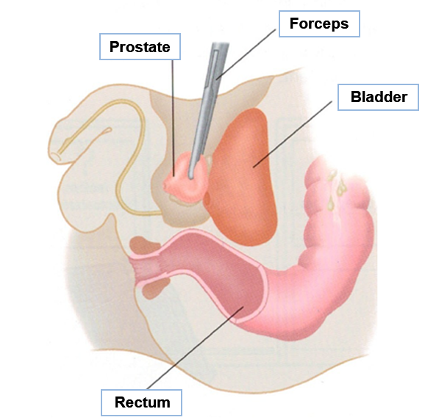
Surgery
3/35
Radical prostatectomy²
Radical prostatectomy¹
Removal of the prostate gland and the resection of the seminal vesicles and the surrounding tissue¹
Often accompanied by pelvic lymph node dissection (PLND)¹
Patient criteria¹
Life expectancy > 10 years
No serious comorbid conditions
Complications of radical prostatectomy¹
Morbidity and mortality associated with a surgical procedure
Urinary incontinence and impotence
Penile shortening
Inguinal hernia
Faecal incontinence
Adapted from Early Prostate Cancer, 2016²
http://uroweb.org/wp-content/uploads/09-Prostate-Cancer_LR.pdf. Accessed April 8, 2016.
http://cancerrecovery.org.uk/cancer-information/types-of-cancer/prostate-cancer/1465-2/. Accessed May 4, 2016.
Notes:
Surgery
Radical prostatectomy involves the removal of the entire prostate gland and the resection of both the seminal vesicles, including sufficient surrounding tissue to obtain a negative margin.¹ /p35/para1 The goal of a radical prostatectomy is to eradicate disease while preserving continence and, if possible, potency. Radical prostatectomy is an appropriate therapy for any patient with a life expectancy of greater than 10 years and with no serious comorbid conditions that would contraindicate an elective operation.¹ /p35/para1
Complications of radical prostatectomy include morbidity and mortality associated with a surgical procedure and use of general anaesthesia, urinary incontinence, impotence, penile shortening, inguinal hernia and faecal incontinence.² /p34/para1
References:
Mottet N, Bellmunt J, Briers E, et al. Guidelines on prostate cancer. European Association of Urology Web site. http://uroweb.org/wp-content/uploads/09-Prostate-Cancer_LR.pdf. Accessed April 8, 2016.
Early prostate cancer. Cancer Recovery Foundation (UK) Web site. http://cancerrecovery.org.uk/cancer-information/types-of-cancer/prostate-cancer/1465-2/. Accessed May 4, 2016.

Slide 17
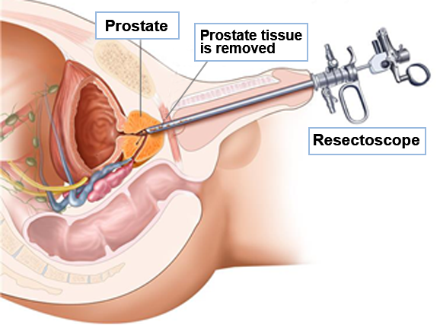
Surgery (cont.)
4/35
Transurethral resection of the prostate (TURP)³
Extended lymph node dissection (eLND) includes removal of all lymph nodes in the external iliac, obturator and internal iliac areas¹
Transurethral resection of the prostate (TURP)²
Removal of the inner part of the prostate gland surrounding the urethra
Often used to treat benign prostatic hyperplasia (BPH)
Sometimes used to relieve symptoms, such as urinary problems, in patients with advanced prostate cancer
Adapted from Prostate Cancer Treatment, 2016³
http://uroweb.org/wp-content/uploads/09-Prostate-Cancer_LR.pdf. Accessed April 8, 2016.
http://www.cancer.org/acs/groups/cid/documents/webcontent/003134-pdf.pdf. Accessed April 4, 2016.
http://www.cancer.gov/types/prostate/patient/prostate-treatment-pdq#section/_142. Accessed May 20, 2016.
Notes:
Surgery (cont.)
Radical prostatectomy is often accompanied by a bilateral pelvic lymph node dissection (PLND).¹ /p35/para1 An extended lymph node dissection (eLND) additionally removes nodes in the external iliac, obturator fossa and internal iliac areas.¹ /p38/para7
Transurethral resection of the prostate (TURP) is an operation where the surgeon removes the inner part of the prostate gland surrounding the urethra. This procedure is more common in treating noncancerous benign prostatic hyperplasia (BPH). However, it may be used in patients with advanced prostate cancer to relieve symptoms such as urinary problems.² /p40/para6-7
References:
Mottet N, Bellmunt J, Briers E, et al. Guidelines on prostate cancer. European Association of Urology Web site. http://uroweb.org/wp-content/uploads/09-Prostate-Cancer_LR.pdf. Accessed April 8, 2016.
Prostate cancer. American Cancer Society Web site. http://www.cancer.org/acs/groups/cid/documents/webcontent/003134-pdf.pdf. Accessed April 4, 2016.

Slide 18
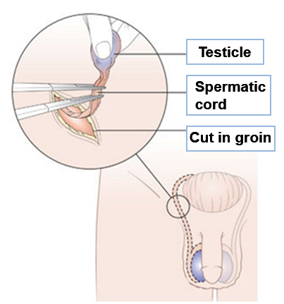
Surgical Castration
5/35
Bilateral orchiectomy¹
Is the gold standard for androgen deprivation therapy (ADT) and involves surgical removal of the testes^{1,2}
Can achieve a mean testosterone value of 15 ng/dL¹
Current accepted definition for castration is a testosterone level < 20 ng/dL, while the level accepted by the regulatory authorities is < 50 ng/dL.¹
Benefits include ease, compliance, immediacy in lowering testosterone and low cost²
Disadvantages include psychological effects, loss of libido, less reversible impotence, hot flashes, osteoporosis, increased risk of coronary heart disease and myocardial infarction²
Orchiectomy³
Adapted from Hormone Therapy, 2016³
http://uroweb.org/wp-content/uploads/09-Prostate-Cancer_LR.pdf. Accessed April 8, 2016.
http://www.ncbi.nlm.nih.gov/books/NBK66036/. Accessed April 5, 2016.
http://www.urologyhealth.org/urologic-conditions/advanced-prostate-cancer/treatment/hormone-therapy. Accessed May 5, 2016.
Notes:
Surgical castration
Suppression of testosterone to levels below 50 ng/dL is termed castration. Castration can be achieved surgically or medically. The European Association of Urology (EAU) considers surgical castration the ‘gold standard’ for ADT.¹ /p56/para3-5
Bilateral orchiectomy is the surgical removal of the testes (where most of the androgens are made), thereby eliminating the testicular production of testosterone. Surgical castration causes most prostate cancers to shrink or stop growing for some time. This form of castration is permanent and patients may have psychological problems accepting the removal of their testicles.² /p49/para1-2 Benefits of bilateral orchiectomy include ease of the procedure, compliance, immediacy in lowering testosterone levels and low cost when compared with other forms of ADT. Besides psychological issues, other risks of surgical castration include loss of libido, less reversible impotence, hot flashes and osteoporosis. Bilateral orchiectomy is also associated with an elevated risk of coronary heart disease and myocardial infarction.³ /p44/para2-4
In the next slide, we will discuss about radiation therapy.
References:
Mottet N, Bellmunt J, Briers E, et al. Guidelines on prostate cancer. European Association of Urology Web site. http://uroweb.org/wp-content/uploads/09-Prostate-Cancer_LR.pdf. Accessed April 8, 2016.
Prostate cancer. American Cancer Society Web site. http://www.cancer.org/acs/groups/cid/documents/webcontent/003134-pdf.pdf. Accessed April 4, 2016.
PDQ Adult Treatment Editorial Board. Prostate cancer treatment (PDQ®): Health professional version. In: PDQ Cancer Information Summaries. Bethesda (MD): National Cancer Institute (US); 2002. http://www.ncbi.nlm.nih.gov/books/NBK66036/. Accessed April 5, 2016.

Slide 19
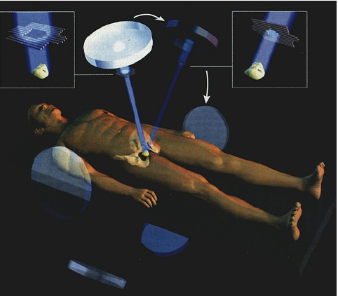
Radiation Therapy
6/35
Utilises high-energy particles or rays to kill cancer cells¹
May be used individually or in combination with hormone therapy or chemotherapy (adjuvant or neoadjuvant)^{1,2}
Types of radiation therapies¹:
External beam radiation therapy (EBRT)
Brachytherapy
Types of EBRT¹:
Three-dimensional conformal radiation therapy (3D-CRT)
Intensity-modulated radiotherapy (IMRT)
Stereotactic body radiation therapy (SBRT)
Proton beam radiation therapy
Complications and side effects of EBRT^{1,3}: Acute cystitis, proctitis, enteritis, fatigue, impotence, lymphoedema, sexual and urinary dysfunctions, increased risk of bladder and gastrointestinal cancers
External beam radiation
therapy (EBRT)³
Adapted from External Beam Radiotherapy, 2016³
http://www.cancer.org/acs/groups/cid/documents/webcontent/003134-pdf.pdf. Accessed April 4, 2016.
http://uroweb.org/wp-content/uploads/09-Prostate-Cancer_LR.pdf. Accessed April 8, 2016.
http://4urology.org/patient_information/treatments/prostate/prostate_cancer/external_beam_radiotherapy/. Accessed May 14, 2016.
Notes:
Radiation therapy
Radiation therapy utilises high-energy particles or rays to kill cancer cells. It can be used individually or in combination with hormone therapy or chemotherapy (both adjuvant and neoadjuvant).^{1,2} /p41/para2-4, /p44/para2-4, /p46/para1 The 2 main types of radiation therapies are external beam radiation therapy (EBRT) and internal radiation therapy or brachytherapy.¹ /p41/para2-4 EBRT may be used to treat localised or locally advanced cancers and to relieve symptoms in case of metastatic prostate cancer.¹ /p41/para6 EBRT therapies include 3-dimensional conformal radiation therapy (3D-CRT), intensity-modulated radiotherapy (IMRT), stereotactic body radiation therapy (SBRT) and proton beam radiation therapy.¹ /p41/para5, /p42/para3-5, /p43/para1-2,4-5 Newer techniques focus more precisely on the tumour, thereby improving the amount of dose that reaches the tumour while limiting the exposure to adjacent healthy tissue.¹ /p42/para3 As per the EAU guidelines, IMRT, with or without image-guided radiotherapy (IGRT), is the gold standard for EBRT.² /p41/para1
Proton beam radiation therapy uses protons instead of X-rays on the cancer. Since protons pass through tissues and release their energy only after travelling a certain distance, they cause minimal damage to normal tissue and deliver more radiation to the tumour. Presently, proton beam therapy is not widely available.¹ /p43/para4-5
Complications of EBRT include acute cystitis, proctitis, enteritis, fatigue, impotence, lymphoedema, sexual and urinary dysfunctions and increased risk of bladder and gastrointestinal cancers.^{1,3} /p43/para6-9, /p44/para3,6-7, /p41/para2-4
References:
Prostate cancer. American Cancer Society Web site. http://www.cancer.org/acs/groups/cid/documents/webcontent/003134-pdf.pdf. Accessed April 4, 2016.
Mottet N, Bellmunt J, Briers E, et al. Guidelines on prostate cancer. European Association of Urology Web site. http://uroweb.org/wp-content/uploads/09-Prostate-Cancer_LR.pdf. Accessed April 8, 2016.
PDQ Adult Treatment Editorial Board. Prostate cancer treatment (PDQ®): Health professional version. In: PDQ Cancer Information Summaries. Bethesda (MD): National Cancer Institute (US); 2002. http://www.ncbi.nlm.nih.gov/books/NBK66036/. Accessed April 5, 2016.

Slide 20
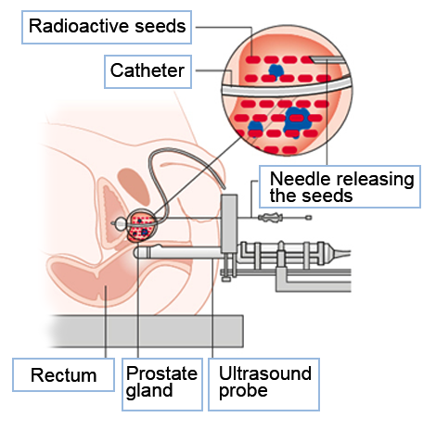
Radiation Therapy (cont.)
7/35
Brachytherapy
Ideal for localised and locally advanced disease^{1,2}
Two methods for prostate brachytherapy³:
Low-dose rate (LDR)³
High-dose rate (HDR)³: Can be used alone or in
combination with EBRT
Salvage brachytherapy³: Can be used to treat local recurrence following EBRT or brachytherapy
Complications and side effects of brachytherapy^{1,2,4}: Radiation proctitis, rectal pain, burning and/or diarrhoea, increased risk of bladder cancer, urinary problems, erection problems
Brachytherapy⁵
Treatment strategies based on risk of patient³
Types of risk
Treatment
Low risk
Low-volume intermediate risk
LDR monotherapy
Intermediate risk
Combination of LDR brachytherapy with EBRT ± 4-6 months of ADT
High risk
Combination of LDR brachytherapy with EBRT ± 2-3 years of ADT
Adapted from Internal Radiotherapy Prostate Cancer, 2016⁵
http://www.cancer.org/acs/groups/cid/documents/webcontent/003134-pdf.pdf. Accessed April 4, 2016.
http://uroweb.org/wp-content/uploads/09-Prostate-Cancer_LR.pdf. Accessed April 8, 2016.
Coit DG, et al. J Natl Compr Canc Netw. 2016;14(4):450-473.
http://www.ncbi.nlm.nih.gov/books/NBK66036/. Accessed April 5, 2016.
http://www.cancerresearchuk.org/about-cancer/type/prostate-cancer/treatment/radiotherapy/internal-radiotherapy-for-prostate-cancer. Accessed May 5, 2016.
Notes:
Radiotherapy (cont.)
Brachytherapy utilises small radioactive pellets, which are placed inside the prostate.¹ /p44/para8 Patients with low-risk prostate cancer are the most suited for this type of treatment.² /p48/para2-4 Brachytherapy can be used to treat localised and locally advanced disease.¹ /p44/para8 There are two methods for prostate brachytherapy namely low-dose rate (LDR) and high-dose rate (HDR) brachytherapy. LDR monotherapy is ideal in patients with low-risk cancer and low-volume intermediate-risk cancer. Patients with intermediate-risk cancer can be treated by combining LDR brachytherapy with EBRT with or without ADT (neoadjuvant/concomitant/adjuvant). Patients with high-risk cancer can be treated with a combination of LDR brachytherapy and EBRT with or without ADT (neoadjuvant/concomitant/adjuvant). HDR brachytherapy can be used alone or in combination with EBRT. Salvage brachytherapy can be used to treat localised recurrence following EBRT or brachytherapy.³ /p26
Complications of brachytherapy include an increased risk of bladder cancer and urinary complications, such as urinary retention and incontinence.^{1,2,4} /p46/para4-6, /p48/para10, /p41/para4
In the next slide, we will discuss hormonal therapies.
References:
Prostate cancer. American Cancer Society Web site. http://www.cancer.org/acs/groups/cid/documents/webcontent/003134-pdf.pdf. Accessed April 4, 2016.
Mottet N, Bellmunt J, Briers E, et al. Guidelines on prostate cancer. European Association of Urology Web site. http://uroweb.org/wp-content/uploads/09-Prostate-Cancer_LR.pdf. Accessed April 8, 2016.
Coit DG, Thompson JA, Algazi A, et al. Melanoma, version 2.2016, NCCN clinical practice guidelines in oncology. J Natl Compr Canc Netw. 2016;14(4):450-473. https://www.nccn.org/professionals/physician_gls/pdf/prostate.pdf. Accessed June 16, 2016.
PDQ Adult Treatment Editorial Board. Prostate cancer treatment (PDQ®): Health professional version. In: PDQ Cancer Information Summaries. Bethesda (MD): National Cancer Institute (US); 2002. http://www.ncbi.nlm.nih.gov/books/NBK66036/. Accessed April 5, 2016.

Slide 21
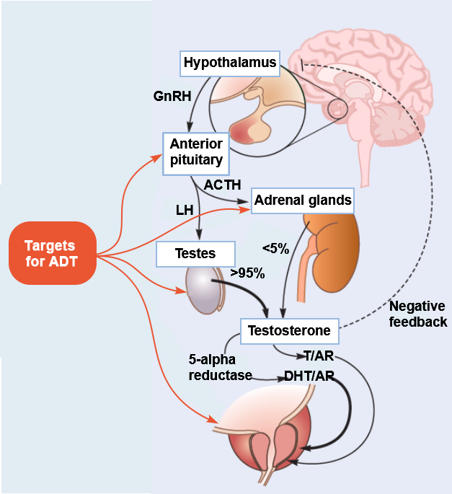
Androgen Deprivation Therapy (ADT): Hypothalamic–Pituitary Axis
8/35
Hypothalamic–pituitary–gonadal axis^{1,2}
Gonadotropin-releasing hormone (GnRH)
Luteinising hormone (LH)
Adrenocorticotropic hormone (ACTH)
Testosterone (T)
5-alpha reductase
Dihydrotestosterone (DHT)
Binds
Androgen receptor (AR)
ADT, androgen deprivation therapy.
Adapted from Lamb, 2013¹; Denmeade, 2010²
Lamb AD, et al. Trends Urol Men’s Health. 2013;4(3):26-30.
Denmeade SR. Holland-Frei Cancer Medicine. 8th ed. Philadelphia, PA: AACR Publications; 2010:750-758.
Notes:
Androgen deprivation therapy: Hypothalamic–pituitary axis
Let us review the hypothalamic–pituitary–gonadal axis that we learnt about in Section 1.
At the very top of the hypothalamus–pituitary axis is the hypothalamus that releases gonadotropin-releasing hormone (GnRH) or luteinising hormone-releasing hormone (LHRH), which reaches the anterior pituitary where it stimulates the release of luteinising hormone (LH) and adrenocorticotropic hormone (ACTH). These hormones in turn act on the testes and adrenal gland, respectively. The testes produces 95% of the circulating testosterone (T) upon stimulation by LH while the adrenal gland produces androstenedione and dehydroepiandrosterone, both precursors to testosterone, on stimulation by ACTH. Testosterone is converted to dihydrotestosterone (DHT) by the enzyme 5-alpha reductase. Both T and DHT can act as ligands to the androgen receptor (AR). Feedback loops are responsible for modulating the secretions from the pituitary and the hypothalamus.¹ /p26/Fig1
In prostate cancer, androgen ablation therapies (ADT) can be used to deprive androgen-dependent cancer cells of androgen stimulation. This can be achieved by surgical removal of testes or suppression of LH release from pituitary or inhibition of androgenic synthesis from testes and adrenals or inhibition of androgen action at the level of androgen-dependent prostatic cancer cells.² /p751/col1/para2
The next few slides will detail various androgen ablation therapies.
References:
Lamb AD, Neal DE. Role of the androgen receptor in prostate cancer. Trends Urol Men’s Health. 2013;4(3):26-30. doi:10.1002/tre.331.
Denmeade SR. Androgen deprivation strategies in the treatment of advanced prostate cancer. In: Hong WK, Bast RC Jr, Hait WN, et al, eds. Holland-Frei Cancer Medicine. 8th ed. Philadelphia, PA: AACR Publications; 2010:750-758.

Slide 22
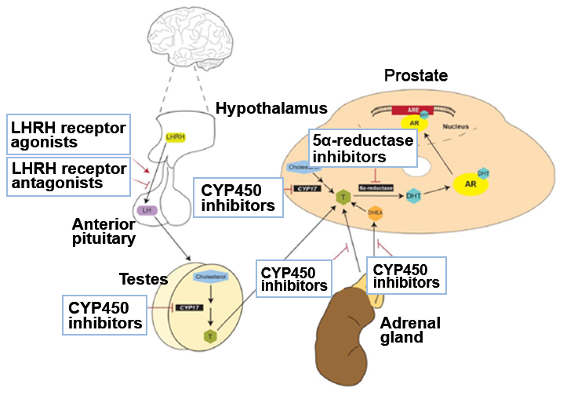
Androgen Deprivation Therapy
9/35
Physiological and anatomical targets of prostate cancer treatment agents¹
Current hormonal strategies¹
Pre-receptor¹: Block the synthesis of testosterone
Drug classes
LHRH receptor agonists
LHRH receptor antagonists
CYP450 inhibitors
5α-reductase inhibitors
AR, androgen receptor; ARE, androgen response element; CYP17, cytochrome P450-C17; CYP450, Cytochromes P450; DHEA, dehydroepiandrosterone; DHT, dihydrotestosterone; LH, luteinising hormone; LHRH, luteinising hormone-releasing hormone; T, testosterone.
Adapted from Wadosky, 2016¹
Wadosky KM, et al. Int J Biol Sci. 2016;12(4):409-426.
Notes:
Androgen deprivation therapy
ADT (also known as hormone therapy) involves the removal of male hormones from the body, or blocking their action.¹ /p59/col1/para3 Current hormonal strategies can be divided into 3 categories: pre-receptor, receptor and post-receptor.² /p413/col2/para3
Pre-receptor strategies aim to block the synthesis of testosterone and reduce its level to less than 0.5 ng/mL, a level described as castration level.² /p413/col2/para3 The pre-receptor strategies include LHRH receptor agonists, LHRH receptor antagonists, cytochrome P450 (CYP450) inhibitors and 5α-reductase inhibitors.² /p415/Table1 LHRH agonists include leuprorelin, goserelin, triptorelin and histrelin. LHRH antagonists include abarelix and degarelix. CYP450 inhibitors include abiraterone and ketoconazole. Five-alpha-reductase inhibitors include finasteride and dutasteride.² /p415/Table1
References:
Advanced prostate cancer: a guide for men and their families. Cancer Council Australia Web site. http://www.cancer.org.au/content/pdf/HealthProfessionals/ClinicalGuidelines/Advanced_Prostate_Cancer_Guide_2009_BOOKMARKS.pdf. Accessed June 10, 2016.
Wadosky KM, Koochekpour S. Therapeutic rationales, progresses, failures and future directions for advanced prostate cancer. Int J Biol Sci. 2016;12(4):409-426. doi:10.7150/ijbs.14090.

Slide 23
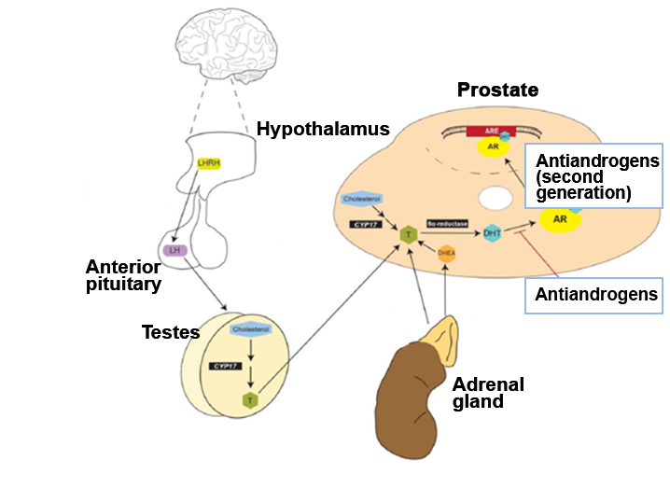
Androgen Deprivation Therapy (cont.)
10/35
Physiological and anatomical targets of prostate cancer treatment agents¹
Current hormonal strategies¹
Receptor¹: Decrease or inhibit androgen receptor (AR) expression and activity
Drug classes
First-generation AR antagonists
Second-generation AR antagonists
Inhibitors of AR expression
Post-receptor¹: Target the proteins involved in AR stability and AR-dependent gene expression
Drugs still in development
AR, androgen receptor; ARE, androgen response element; CYP17, cytochrome P450-C17; DHEA, dehydroepiandrosterone; DHT, dihydrotestosterone; LH, luteinising hormone; LHRH, luteinising hormone-releasing hormone; T, testosterone.
Adapted from Wadosky, 2016¹
Wadosky KM, et al. Int J Biol Sci. 2016;12(4):409-426.
Notes:
Androgen deprivation therapy (cont.)
Receptor strategies are aimed to decrease or inhibit AR expression and activity.¹ /p418/col1/para2 The receptor strategies include first- and second-generation AR antagonists and inhibitors of AR expression.¹ /p419/Table2 First-generation AR antagonists include flutamide, bicalutamide and nilutamide. The only second-generation FDA-approved AR antagonist is enzalutamide. Inhibitors of AR expression are still in development.¹ /p419/Table2
Finally, post-receptor strategies are aimed at proteins involved in AR stability and AR-dependent gene expression.¹ /p421/col1/para2 All the drugs in this category are still in preclinical or phase-2 development.¹ /p422/Table3
In the next slides, we will discuss the mechanism of action of each class of agents and associated side effects.
Reference:
Wadosky KM, Koochekpour S. Therapeutic rationales, progresses, failures and future directions for advanced prostate cancer. Int J Biol Sci. 2016;12(4):409-426. doi:10.7150/ijbs.14090.

Slide 24
Androgen Deprivation Therapy (cont.)
11/35
Description of various drug classes¹⁻⁴
Drug class
Approved
drugs
Mechanism of action
Comments
LHRH
receptor
agonists¹
Leuprorelin¹
Goserelin¹
Histrelin¹
Triptorelin¹
Buserelin²
Stimulates the LHRH receptors constantly
leading to receptor desensitisation, thereby
resulting in a permanent decrease in
receptor expression and creation of
negative feedback¹
• Produces a surge in LH, FSH
and testosterone⁴
Equivalent to orchiectomy in survival,
clinical outcomes and time to
disease progression¹
• Testosterone flare on
first administration³
• Long-acting depot formulations
available⁴
LHRH
receptor
antagonists¹
Degarelix¹
Abarelix¹
Binds competitively to the LHRH receptors in the pituitary gland
rapidly decreasing LH,
FSH and testosterone levels⁴
The majority of patients (95%) achieve
castrate level by day 3⁴
Abarelix has been suspended due to
associated allergic reactions¹
FSH, follicle-stimulating hormone; LH, luteinising hormone; LHRH, luteinising hormone-releasing hormone.
Adapted from Wadosky, 2016¹; Prostate Cancer, 2016²; PDQ Adult Treatment Editorial Board, 2016³; Mottet, 2015⁴
Wadosky KM, et al. Int J Biol Sci. 2016;12(4):409-426.
http://www.ncbi.nlm.nih.gov/books/NBK66036/. Accessed April 5, 2016.
http://www.cancer.org/acs/groups/cid/documents/webcontent/003134-pdf.pdf. Accessed April 4, 2016.
http://uroweb.org/wp-content/uploads/09-Prostate-Cancer_LR.pdf. Accessed April 8, 2016.
Notes:
Androgen deprivation therapy (cont.)
Constant stimulation of LHRH receptors by LHRH agonists desensitises the receptor, resulting in a decrease in receptor expression and creation of negative feedback. Consequently, future LHRH production does not stimulate LH production by the anterior pituitary, thereby indirectly inhibiting downstream testosterone production.¹ /p414/col1/para1-2, /col2/para1 Leuprorelin was the first LHRH agonist to be approved followed by goserelin. Triptorelin and histrelin were approved in the early 2000s.¹ /p414/col2/para2 A meta-analysis of 10 randomised trials concluded that LHRH agonist treatment is equivalent to orchiectomy in terms of survival, clinical outcomes and time to disease progression.¹ /p414/col2/para2
LHRH antagonists rapidly decrease LH, follicle-stimulating hormone (FSH) and testosterone levels in patients by binding immediately and competitively to LHRH receptors. Of the 2 available antagonists, the use of abarelix has been suspended due to associated allergic reaction. Degarelix is available as a monthly subcutaneous formulation and effectively achieves castration status in 95% of patients by day 3.² /p57/para11-12, /p58/para1-2 Abarelix has been suspended due to associated allergic reactions.¹ /p415/col1/para2
References:
Wadosky KM, Koochekpour S. Therapeutic rationales, progresses, failures and future directions for advanced prostate cancer. Int J Biol Sci. 2016;12(4):409-426. doi:10.7150/ijbs.14090.
Mottet N, Bellmunt J, Briers E, et al. Guidelines on prostate cancer. European Association of Urology Web site. http://uroweb.org/wp-content/uploads/09-Prostate-Cancer_LR.pdf. Accessed April 8, 2016.

Slide 25
Androgen Deprivation Therapy (cont.)
12/35
Description of various drug classes¹⁻³ (cont.)
Drug class | Approved drugs | Mechanism of action | Comments
CYP450 inhibitors (androgen synthesis inhibitors)¹ | Abiraterone acetate¹ Ketoconazole¹ | Block hydrolase and lyase activities of CYP450-17 enzyme, thereby preventing androgen production by prostate cancer cells.^{1,2} | Patients who have not had an orchiectomy need to use these drugs in combination with an LHRH agonist or antagonist.² Prednisone must be used in conjunction with CYP450 inhibitors to avoid side effects.²
5α-reductase inhibitors¹ | Finasteride¹ Dutasteride¹ | Inhibit 5α-reductase enzyme preventing the conversion of testosterone to DHT.¹ | This intervention is only approved for the treatment of BPH.¹
BPH, benign prostatic hyperplasia; CYP450, cytochrome P450; DHT, dihydrotestosterone; EAU, European Association of Urology; LHRH, luteinising hormone-releasing hormone.
Adapted from Wadosky, 2016¹; Prostate Cancer, 2016²; Mottet, 2015³
Wadosky KM, et al. Int J Biol Sci. 2016;12(4):409-426.
http://www.cancer.org/acs/groups/cid/documents/webcontent/003134-pdf.pdf. Accessed April 4, 2016.
Notes:
Androgen deprivation therapy (cont.)
Although LHRH agonists and antagonists block androgen production in the testicles, other cells in the body, such as prostate cancer cells, still continue to produce small amounts of androgens. CYP450 inhibitors are able to block certain CYP450 enzymes, which stop androgen production in the prostate cancer cells. Since CYP450 inhibitors do not stop the testicles from producing testosterone, patients who have not had surgical castration must use these drugs in conjunction with an LHRH agonist or antagonist. Additionally, to avoid side effects, these drugs are used in conjunction with prednisone or prednisolone.¹ /p50/para3-5
The main CYP450 enzyme involved in testosterone production is CYP450-17. Blocking this enzyme will suppress gonadal, adrenal and intratumoural androgen production.² /p416/col1/para2 Abiraterone irreversibly inhibits both hydrolase and lyase activities of CYP450-17.² /p416/col1/para2
Five-alpha-reductase inhibitors are currently approved only for the treatment of BPH and their ability to lower the risk of developing prostate cancer is still being studied.¹ /p9/para8
References:
Prostate cancer. American Cancer Society Web site. http://www.cancer.org/acs/groups/cid/documents/webcontent/003134-pdf.pdf. Accessed April 4, 2016.
Wadosky KM, Koochekpour S. Therapeutic rationales, progresses, failures and future directions for advanced prostate cancer. Int J Biol Sci. 2016;12(4):409-426. doi:10.7150/ijbs.14090.

Slide 26
Androgen Deprivation Therapy (cont.)
13/35
Description of various drug classes^{1,2} (cont.)
Drug class | Approved drugs | Mechanism of action | Comments
Antiandrogens¹ | Steroidal¹ Cyproterone acetateª Megestrol acetate Medroxyprogesterone acetateª Nonsteroidal¹ Flutamide Bicalutamide Nilutamide | Both classes compete with endogenous androgens to bind to the androgen receptor.¹ | Steroidal¹ Shows cardiovascular toxicity and hepatotoxicity Nonsteroidal¹ Improves quality of life and compliance Shows fatal liver toxicity
Antiandrogen (second generation)² | Enzalutamide^{1,2} | Shows 4-fold increased binding affinity for ARs compared with bicalutamide² | Shows superiority to first-generation antiandrogens² Shows significant overall improvement in survival¹
ªNot approved for the treatment of prostate cancer in the United States²
AR, androgen receptor; DNA, deoxyribonucleic acid.
Adapted from Mottet, 2015¹; Wadosky, 2016²
http://uroweb.org/wp-content/uploads/09-Prostate-Cancer_LR.pdf. Accessed April 8, 2016.
Wadosky KM, et al. Int J Biol Sci. 2016;12(4):409-426.
Notes:
Androgen deprivation therapy (cont.)
Antiandrogens are classified as steroidal and nonsteroidal. Antiandrogens act by competing with endogenous androgens to bind to the androgen receptor. The steroidal antiandrogens are not currently approved for the treatment of prostate cancer due to serious side effects accompanying their use.^{1,2} /p58/para9, /p418/col1/para2
Nonsteroidal antiandrogen monotherapy can improve patient’s quality of life and compliance compared with castration. Of the approved first-generation antiandrogens, bicalutamide has a more favourable safety profile than flutamide or nilutamide.¹ /p58/para9
Enzalutamide is a second-generation AR antagonist that shows a 4-fold increase in binding affinity to the AR compared with bicalutamide. These are superior to first-generation antiandrogens.² /p419/col1/para2
References:
Mottet N, Bellmunt J, Briers E, et al. Guidelines on prostate cancer. European Association of Urology Web site. http://uroweb.org/wp-content/uploads/09-Prostate-Cancer_LR.pdf. Accessed April 8, 2016.
Wadosky KM, Koochekpour S. Therapeutic rationales, progresses, failures and future directions for advanced prostate cancer. Int J Biol Sci. 2016;12(4):409-426. doi:10.7150/ijbs.14090.

Slide 27
Androgen Deprivation Therapy (cont.)
14/35
Description of various drug classes¹ (cont.)
Drug class | Approved drugs | Mechanism of action | Comments
Oestrogens | Diethylstilboestrol (DES)ª | Testosterone suppression¹ | Oestrogens exhibit severe cardiovascular morbidity and mortality.¹ They are no longer in use due to the associated side effects.¹
ªNo longer available/used¹
Adapted from Mottet, 2015¹
http://uroweb.org/wp-content/uploads/09-Prostate-Cancer_LR.pdf. Accessed April 8, 2016.
Notes:
Androgen deprivation therapy (cont.)
Oestrogens once used to be the main therapeutic option for prostate cancer but are no longer in use due to their severe cardiovascular side effects.¹ /p57/para2-4
Reference:
Mottet N, Bellmunt J, Briers E, et al. Guidelines on prostate cancer. European Association of Urology Web site. http://uroweb.org/wp-content/uploads/09-Prostate-Cancer_LR.pdf. Accessed April 8, 2016.

Slide 28
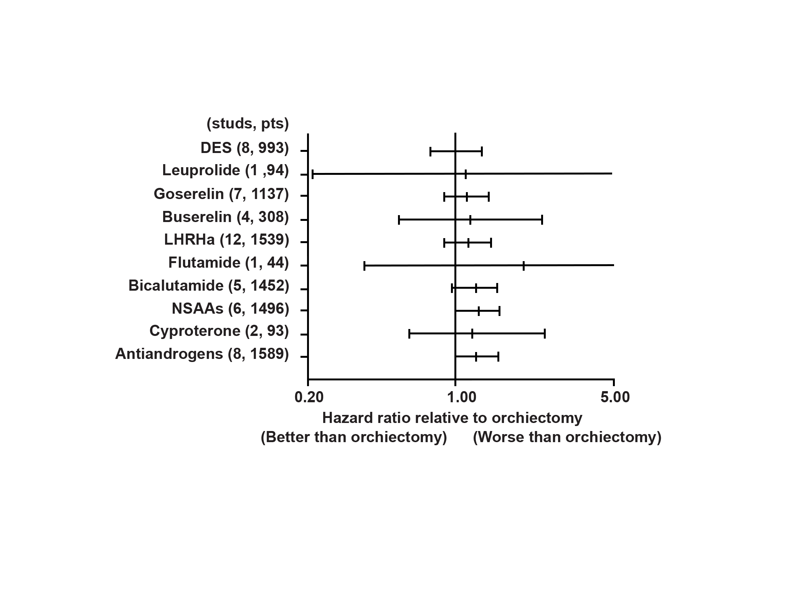
ADT Monotherapy
15/35
Hazard ratio for survival relative to orchiectomy¹
Nonsteroidal antiandrogen (NSAA) monotherapy compared with medical or surgical castration monotherapy for advanced prostate cancer was found to be less effective in terms of²:
Overall survival
Clinical progression
Treatment failure
Treatment discontinuation due to adverse effects
DES, diethylstilboestrol; LHRHa, luteinising hormone-releasing hormone agonist; NSAA, nonsteroidal antiandrogen; pts, pooled number of patients; studs, number of studies.
Adapted from Lepor, 2005¹
Lepor H. Rev Urol. 2005;7(Suppl 5):S3-S12.
http://uroweb.org/wp-content/uploads/09-Prostate-Cancer_LR.pdf. Accessed April 8, 2016.
Notes:
ADT monotherapy
There are a very few trials that compare ADT monotherapies in patients with advanced prostate cancer.¹ /pS8/col1/para2 A meta-analysis of 24 randomised and controlled trials demonstrated no significant difference between orchiectomy versus LHRH agonist monotherapy and no significant difference between the different LHRH agonists. The analysis also demonstrated that antiandrogens were not as effective as orchiectomy for survival in men with advanced prostate cancer.¹ /pS8/col1/para2, /col2/para2, /col3/para1-2, /pS9Fig3, /col1/para1 Additionally, the incidence of hot flushes did not differ between the various LHRH agonists and LHRH antagonists were found to have superior tolerability compared with antiandrogens.¹ /pS9/col1/para2, /col2/para1 In fact, a Cochrane review concluded that nonsteroidal antiandrogen (NSAA) monotherapy is less effective than medical or surgical castration in terms of overall survival, clinical progression, treatment failure and treatment discontinuation due to adverse effects.² /p60/para4
References:
Lepor H. Comparison of single-agent androgen suppression for advanced prostate cancer. Rev Urol. 2005;7(Suppl 5):S3-S12.
Mottet N, Bellmunt J, Briers E, et al. Guidelines on prostate cancer. European Association of Urology Web site. http://uroweb.org/wp-content/uploads/09-Prostate-Cancer_LR.pdf. Accessed April 8, 2016.

Slide 29
ADT Monotherapy (cont.)
16/35
Hazard ratio for survival relative to orchiectomy¹ (cont.)
Patients suited for ADT monotherapy
Patients with symptomatic and asymptomatic high-risk localised prostate cancer who are unable or unwilling to receive any form of local treatment²
Patients with high-risk locally advanced prostate cancer²
Monotherapy is not recommended for patients with M1 metastatic prostate cancer.²
DES, diethylstilboestrol; LHRHa, luteinising hormone-releasing hormone agonist; NSAA, nonsteroidal antiandrogen; pts, pooled number of patients; studs, number of studies.
Adapted from Lepor, 2005¹
Lepor H. Rev Urol. 2005;7(Suppl 5):S3-S12.
http://uroweb.org/wp-content/uploads/09-Prostate-Cancer_LR.pdf. Accessed April 8, 2016.
Notes:
ADT monotherapy (cont.)
Androgen suppression monotherapy in patients with high-risk localised prostate cancer is reserved for symptomatic as well as asymptomatic patients unwilling or unable to receive any form of local treatment.¹ /p78/Table ADT monotherapy may also be administered to patients with high-risk locally advanced prostate cancer.¹ /p77/Table Finally, antiandrogen monotherapy should not be considered in patients with M1 metastatic prostate cancer.¹ /p79/Table
Reference:
Mottet N, Bellmunt J, Briers E, et al. Guidelines on prostate cancer. European Association of Urology Web site. http://uroweb.org/wp-content/uploads/09-Prostate-Cancer_LR.pdf. Accessed April 8, 2016.

Slide 30
Side Effects of ADT
17/35
Side effects of ADT¹
Loss of libido,
erectile dysfunction
Cardiovascular morbidity
Cognitive defects
ADT
Altered body
composition
Fatigue
ADT
Metabolic disturbances
Arterial stiffness
Osteoporosis,
skeletal fractures
ADT, androgen deprivation therapy.
Sountoulides P, et al. ISRN Urol. 2013;2013:240108.
Notes:
Side effects of ADT
There are many documented side effects of ADT that play a role in patient’s quality of life. Some of these include the ‘flare’ phenomenon seen with LHRH agonists, hot flashes, sexual dysfunction (loss of libido and erectile dysfunction), fatigue, changes in body composition (gynaecomastia, weight gain, reduced muscle mass and increased abdominal fat), skeletal morbidity (osteoporosis and skeletal fractures), psychological and cognitive effects, anaemia, metabolic syndrome (hyperglycaemia, altered lipoprotein profile and decreased insulin sensitivity) and cardiovascular morbidity.¹ /p2/col1/para2, /p5/co1/para4, /p3/col1/para5.
Strategies to minimise complications associated with ADT include patient education on side effects and coping strategies. Other strategies include intermittent hormonal therapy (IHT) and methods to reduce the amount of intracellular androgens without reducing circulating testosterone levels.¹ /p5/col2/para2-3
Reference:
Sountoulides P, Rountos T. Adverse effects of androgen deprivation therapy for prostate cancer: prevention and management. ISRN Urol. 2013;2013:240108. doi:10.1155/2013/240108.

Slide 31
Adjuvant and Neoadjuvant ADT
18/35
Value of neoadjuvant ADT in men with high-risk localised and locally advanced disease is established.¹
Neoadjuvant or adjuvant hormone therapy plus radiotherapy²
Combination therapy is superior to radiotherapy alone, followed by deferred ADT on relapse in patients with locally advanced cancer.
Guidelines
European Association of Urology (EAU) guidelines¹
Combination of radiotherapy and ADT in patients with locally advanced prostate cancer is standard practice
European Society for Medical Oncology (ESMO) guidelines²
ADT (neoadjuvant and concurrent) for 4-6 months in men with intermediate-risk and in men receiving radical radiotherapy for high-risk disease.
ADT (adjuvant) for 2-3 years in men receiving neoadjuvant hormone therapy (NHT), radical radiotherapy and in those who are at high risk of prostate cancer mortality.
http://uroweb.org/wp-content/uploads/09-Prostate-Cancer_LR.pdf. Accessed April 8, 2016.
Parker C, et al. Ann Oncol. 2015;26(Suppl 5):v69-v77.
Notes:
Adjuvant and neoadjuvant ADT
The value of neoadjuvant ADT in men with high-risk localised and locally advanced disease is established.¹ /pv71/col2/para1,3
A combination of radiotherapy and ADT in patients with locally advanced cancer is standard practice as per the European Association of Urology (EAU) guidelines. This is based on the results from the phase 3 trials that concluded that a combination of ADT and radiotherapy is superior to radiotherapy alone in patients with locally advanced cancer.² /p44/para1-3 In practice, ADT is initiated at the onset of radiotherapy (for adjuvant ADT) or 2-3 months before (for neoadjuvant ADT).² /p44/para1-3
The European Society for Medical Oncology (ESMO) guidelines recommend neoadjuvant and concurrent ADT for 4-6 months in men receiving radical radiotherapy for high-risk disease, and possibly the same treatment for men with intermediate-risk. The guidelines also recommend adjuvant ADT for 2-3 years in men receiving neoadjuvant hormone therapy and radical radiotherapy and in those who are at high risk of prostate cancer mortality.¹ /pv71/col2/para1,3
References:
Parker C, Gillessen S, Heidenreich A, Horwich A, ESMO Guidelines Committee. Cancer of the prostate: ESMO clinical practice guidelines for diagnosis, treatment, and follow-up. Ann Oncol. 2015;26(Suppl 5):v69-v77. doi:10.1093/annonc/mdv222.
Mottet N, Bellmunt J, Briers E, et al. Guidelines on prostate cancer. European Association of Urology Web site. http://uroweb.org/wp-content/uploads/09-Prostate-Cancer_LR.pdf. Accessed April 8, 2016.

Slide 32
ADT Combination Therapies
19/35
Combination therapies used to treat metastatic prostate cancer¹
Combined androgen blockade (CAB)^{1,2}
Comparison of CAB and monotherapy showed conflicting data.
Largest randomised clinical trial found no difference between surgical castration with or without flutamide.
LHRH analogues with nonsteroidal antiandrogens (NSAA) achieved the highest quality-adjusted survival.
CAB is associated with increased side effects.
CAB is also associated with increased treatment costs.
http://uroweb.org/wp-content/uploads/09-Prostate-Cancer_LR.pdf. Accessed April 8, 2016.
Heidenreich A, et al. Eur Urol. 2014;65(2):467-479.
Notes:
ADT combination therapies
Combination therapies, such as intermittent or short-term hormonal treatments, are used for the treatment of metastatic prostate cancer.¹ /p60/para3,5, /p63/para2
ADT can be achieved by suppressing the release of testosterone or inhibiting the action of androgens at the receptor level using antiandrogens. Using both these methods in combination results in maximal androgen blockade or complete androgen blockade (CAB). The effectiveness of this combination compared with monotherapy is still unclear.² /p51/para1 In fact, a large randomised clinical trial found no difference between surgical castration with and without flutamide. It appears that the highest quality-adjusted survival rates can be achieved by combining LHRH analogues with nonsteroidal antiandrogens (NSAAs).² /p60/para3-4 CAB is also associated with increased side effects, such as impairment of sexual function, cognitive function and higher costs.^{1,3} /p60/para3-4, /p469/col2/para1
References:
Mottet N, Bellmunt J, Briers E, et al. Guidelines on prostate cancer. European Association of Urology Web site. http://uroweb.org/wp-content/uploads/09-Prostate-Cancer_LR.pdf. Accessed April 8, 2016.
Prostate cancer. American Cancer Society Web site. http://www.cancer.org/acs/groups/cid/documents/webcontent/003134-pdf.pdf. Accessed April 4, 2016.
Heidenreich A, Bastian PJ, Bellmunt J, et al. EAU guidelines on prostate cancer. Part II: treatment of advanced, relapsing, and castration-resistant prostate cancer. Eur Urol. 2014;65(2):467-479. doi:10.1016/j.eururo.2013.11.002.

Slide 33
ADT Combination Therapies (cont.)
20/35
Immediate versus deferred ADT¹
Controversy exists regarding the time of introduction of hormone therapy in
asymptomatic patients.
ADT is most cost-effective if started at the onset of symptomatic metastases.
Immediate ADT does not improve overall survival but reduces disease progression and complication rates.
ESMO and EAU guidelines offer no recommendations for immediate vs. deferred ADT.
http://uroweb.org/wp-content/uploads/09-Prostate-Cancer_LR.pdf. Accessed April 8, 2016.
Notes:
ADT combination therapies (cont.)
There is some controversy regarding when to introduce hormone therapy in asymptomatic patients. ADT appears to be most cost-effective if it is started at the onset of symptomatic metastases. Studies have shown no improvement in overall survival following immediate ADT, but there is a reduction in both complication rates and disease progression with immediate ADT. EAU and ESMO guidelines offer no recommendation for immediate versus deferred ADT.¹ /p63/para2-5
Reference:
Mottet N, Bellmunt J, Briers E, et al. Guidelines on prostate cancer. European Association of Urology Web site. http://uroweb.org/wp-content/uploads/09-Prostate-Cancer_LR.pdf. Accessed April 8, 2016.

Slide 34
ADT Combination Therapies (cont.)
21/35
Intermittent androgen deprivation therapy (IAD) versus continuous ADT^{1,2}
IAD can delay the appearance of androgen-independent prostate cancer.
There are 2 types of IADs:
Fixed on and off therapy periods
On and off periods based on high and low prostate-specific antigen (PSA) levels
There is no significant difference in overall survival and quality of life between IAD and continuous ADT.
Some side effects reduced with IAD compared with continuous ADT.
Bone protection
Metabolic syndrome
IAD is associated with significant decrease in treatment costs
http://www.cancer.org/acs/groups/cid/documents/webcontent/003134-pdf.pdf. Accessed April 4, 2016.
http://uroweb.org/wp-content/uploads/09-Prostate-Cancer_LR.pdf. Accessed April 8, 2016.
Notes:
ADT combination therapies (cont.)
Most prostate cancers develop resistance to hormone therapy over time. In order to overcome this, hormone therapy can be given intermittently. The added advantage of intermittent androgen deprivation therapy (IAD) is the reduction in side effects while hormone therapy is paused (i.e., during the ‘off’ stage of therapy).¹ /p53/para7-8 One type of IAD uses PSA levels to stop or resume therapy, with treatment paused when levels are low and treatment resumed when PSA levels rise. Other types maintain fixed on and off therapy periods.¹ /p53/para7-8 IAD can potentially delay the appearance of androgen independence. However, results from trials have concluded that there is no significant difference in overall survival and overall quality of life between the continuous and intermittent ADT groups. IAD only showed a reduction in some side effects as compared with continuous ADT.² /p60/para5-7 Over the long term, IAD seems to protect bones and also protect against metabolic syndrome. IAD is also associated with significant lowering of treatment costs.² /p62/para1-2
In the next slide, we will discuss about chemotherapy.
References:
Prostate cancer. American Cancer Society Web site. http://www.cancer.org/acs/groups/cid/documents/webcontent/003134-pdf.pdf. Accessed April 4, 2016.
Mottet N, Bellmunt J, Briers E, et al. Guidelines on prostate cancer. European Association of Urology Web site. http://uroweb.org/wp-content/uploads/09-Prostate-Cancer_LR.pdf. Accessed April 8, 2016.

Slide 35
Chemotherapy
22/35
Typically used in combination with a steroid drug¹
Examples¹:
Docetaxel
Mitoxantrone
Typically given in cycles interrupted by periods of rest¹
Side effects¹:
Cabazitaxel
Estramustine
Hair loss
Mouth sores
Loss of appetite
Nausea/vomiting
Diarrhoea
Increase chances of infections
Easy bruising/bleeding
Fatigue
Severe allergic reactions and peripheral neuropathy (e.g., with docetaxel)
http://www.cancer.org/acs/groups/cid/documents/webcontent/003134-pdf.pdf. Accessed April 4, 2016.
Notes:
Chemotherapy
Chemotherapeutic agents used for prostate cancer include docetaxel, cabazitaxel, mitoxantrone and estramustine. These are typically used one at a time.¹ /p55/para2-5 Chemotherapeutic agents are typically given in cycles interrupted by periods of rest to allow the body time to recover. Each cycle typically lasts for a few weeks.¹ /p55/para5
Chemotherapeutic drugs attack rapidly dividing cells, and as such tissues with dividing cells such as the bone marrow or the lining of the mouth are vulnerable. Some common side effects include hair loss, mouth sores, loss of appetite, vomiting, nausea, diarrhoea, increased chance of infections, fatigue and easy bruising or bleeding.¹ /p55/para6-7,/p56/para1-4 Side effects commonly seen with docetaxel and cabazitaxel include severe allergic reactions and nerve damage. Mitoxantrone can cause leukaemia, though this is very rare. Estramustine increases the likelihood of blood clots.¹ /p56/para2-5
Reference:
Prostate cancer. American Cancer Society Web site. http://www.cancer.org/acs/groups/cid/documents/webcontent/003134-pdf.pdf. Accessed April 4, 2016.

Slide 36
Chemotherapy (cont.)
23/35
ADT + docetaxel for patients with ADT-naïve metastatic disease.¹
Chemotherapy may be considered for men with asymptomatic or minimally symptomatic metastatic castration-resistant prostate cancer (mCRPC).¹
Docetaxel with or without prednisone is the preferred first line of treatment for symptomatic mCRPC [the National Comprehensive Cancer Network (NCCN), guidelines].¹
Mitoxantrone and prednisone provide palliation but do not extend survival.¹
Cabazitaxel with prednisone can prolong overall survival compared with mitoxantrone and prednisone and is the second-line choice in a post-docetaxel setting.¹
Patients with no evidence of progression with prior docetaxel can be retreated with docetaxel.¹
There is no chemotherapeutic regimen after cabazitaxel treatment that can prolong survival and quality of life; patients must participate in clinical trials.¹
Coit DG, et al. J Natl Compr Canc Netw. 2016;14(4):450-473.
Notes:
Chemotherapy (cont.)
The first line of chemotherapy is usually docetaxel combined with a steroid (prednisone). If this does not work or stops working, cabazitaxel is typically chosen next. It must be noted that chemotherapy is very unlikely to cure prostate cancer. Chemotherapy is typically used for the treatment of metastatic prostate cancer, more specifically CRPC.¹ /p55/para2-5
Chemotherapeutic regimens are typically used in cases of metastatic prostate cancer. In cases of ADT-naïve metastatic disease, ADT with docetaxel is a treatment option. In patients with metastatic castration-resistant prostate cancer (mCRPC), docetaxel with prednisone is the preferred first line of treatment [the National Comprehensive Cancer Network (NCCN), guidelines]. Cabazitaxel with prednisone is preferred over mitoxantrone and prednisone as the second line of treatment in a post-docetaxel setting. Patients who did not demonstrate evidence of progression with docetaxel may be given docetaxel again. Patients not responding to cabazitaxel must try to enrol in a clinical trial as currently there are no treatment options shown to prolong survival or improve quality of life post cabazitaxel treatment.² /p33-34
In the next slide, we will discuss about bone-directed treatments.
References:
Prostate cancer. American Cancer Society Web site. http://www.cancer.org/acs/groups/cid/documents/webcontent/003134-pdf.pdf. Accessed April 4, 2016.
Coit DG, Thompson JA, Algazi A, et al. Melanoma, version 2.2016, NCCN clinical practice guidelines in oncology. J Natl Compr Canc Netw. 2016;14(4):450-473. https://www.nccn.org/professionals/physician_gls/pdf/prostate.pdf. Accessed June 16, 2016.

Slide 37
Bone-Directed Treatments
24/35
Hormone therapy, chemotherapy and vaccines can treat bone metastasis.¹
Specific bone-directed treatments are more effective.¹
Treatment choices include^{1,2}:
Bisphosphonates: zoledronic acid
Denosumab
Note: Vitamin D and calcium supplements are recommended during treatment with denosumab and bisphosphonates.
Corticosteroids: prednisone, dexamethasone
External radiation therapy
Radiopharmaceuticals: strontium-89, samarium-153, radium-223
Pain medications: ibuprofen, acetaminophen, morphine
http://www.cancer.org/acs/groups/cid/documents/webcontent/003134-pdf.pdf. Accessed April 4, 2016.
http://uroweb.org/wp-content/uploads/09-Prostate-Cancer_LR.pdf. Accessed April 8, 2016.
Notes:
Bone-directed treatments
While, hormone therapy, chemotherapy and vaccine can treat bone metastases, there are specific bone-directed treatments that are more effective for slowing bone metastasis and managing pain.¹ /p57/para5
Bisphosphonates are used to relieve pain and to slow the growth of cancer. Zoledronic acid is the most commonly used bisphosphonate. Side effects include flu-like symptoms, kidney problems and bone or joint pain. A rare but serious side effect is osteonecrosis of the jaw.¹ /p57/para5-6, /p58/para1-4 Denosumab also blocks bone cells like bisphosphonates and may be helpful in patients not responding to zoledronic acid. Side effects are similar to bisphosphonates including osteonecrosis of the jaw in rare cases. Vitamin D and calcium is recommended along with denosumab to avoid low calcium levels. Corticosteroids can also be used to relieve pain and lower PSA levels. External radiation therapy is another option especially in cases where pain is limited to one or few areas of the bone. Radiation therapy may also help to shrink tumours and help alleviate pressure on the spinal cord. Radiopharmaceuticals such as strontium-89 or radium-223 are injected into a vein and they migrate to areas of damaged bone, giving off radiation that kills cancer cells. The advantage of these drugs over external radiation therapy is that they can reach all the affected bones at the same time. Side effects include decreased blood counts and as a result, an increased risk of infections. Finally, pain medications ranging from ibuprofen to morphine may be given to patients for pain relief.¹ /p57/para5-6, /p58/para1-4, /p59 Calcium and vitamin D supplements are also recommended when treating patients with denosumab or bisphosphonates.² /p97/Table6.11.11
In the next slide, we will discuss about immunotherapy.
References:
Prostate cancer. American Cancer Society Web site. http://www.cancer.org/acs/groups/cid/documents/webcontent/003134-pdf.pdf. Accessed April 4, 2016.
Mottet N, Bellmunt J, Briers E, et al. Guidelines on prostate cancer. European Association of Urology Web site. http://uroweb.org/wp-content/uploads/09-Prostate-Cancer_LR.pdf. Accessed April 8, 2016.

Slide 38
Immunotherapy
25/35
Immunotherapies have demonstrated a significant overall benefit in patients with castration-resistant prostate cancer (CRPC).¹
Sipuleucel-T^{1,2}
Is an active cellular immunotherapy¹
Is used in hormone-refractory metastatic prostate cancer²
Consists of autologous peripheral blood mononuclear cells that have been exposed ex vivo to a recombinant fusion protein¹
Has side effects such as chills, fever headache, myalgia, sweating and influenza-like symptoms²
PROSTVAC^{1,2}
Is still in clinical trials
Uses a genetically modified virus that contains a PSA
Initiates immune response to the virus
Encourages immune system to recognise and destroy cancer cells
http://uroweb.org/wp-content/uploads/09-Prostate-Cancer_LR.pdf. Accessed April 8, 2016.
http://www.cancer.org/acs/groups/cid/documents/webcontent/003134-pdf.pdf. Accessed April 4, 2016.
Notes:
Immunotherapy
Trials with immunotherapies have demonstrated a significant overall survival benefit in patients with castration-resistant prostate cancer.¹ /p91/para2
The goal of immunotherapy (vaccines) is to boost the patient’s own immune system to help fight and destroy cancer cells.² /p56/para7 Sipuleucel-T consists of autologous peripheral blood mononuclear cells that have been activated in vitro by a recombinant fusion protein composed of prostatic acid phosphatase fused to granulocyte-macrophage colony-stimulating factor.¹ /p93/para3 Side effects are in line with those seen with cytokine release including fever, chills, headache, fatigue, nausea and myalgia. These side effects typically last for a couple of days.² /p57/para2
PROSTVAC uses a genetically modified virus that contains a PSA. The patient’s immune system responds to the virus and recognises and destroys cancer cells containing PSA.² /p82/para3
In the next slide, we will discuss about experimental therapeutic options.
References:
Mottet N, Bellmunt J, Briers E, et al. Guidelines on prostate cancer. European Association of Urology Web site. http://uroweb.org/wp-content/uploads/09-Prostate-Cancer_LR.pdf. Accessed April 8, 2016.
Prostate cancer. American Cancer Society Web site. http://www.cancer.org/acs/groups/cid/documents/webcontent/003134-pdf.pdf. Accessed April 4, 2016.

Slide 39
Experimental Therapeutic Options
26/35
Types of experimental therapies^{1,2}
Experimental therapy | Description | Side effects/complications
HIFU | Uses focussed ultrasound waves to cause tissue damage by mechanical and thermal effects and cavitation¹ | Incontinence¹ Erectile dysfunction¹ Urge incontinence¹ Dysuria¹
Cryosurgery | Uses freezing techniques to inducecell death¹ | Worse in patients who have undergone radiation therapy² Blood in urine² Swelling of penis/scrotum² Pain and burning sensation in bladder and rectum² Increase in the need to empty bladder and bowels² Erectile dysfunction² Urinary incontinence² Development of fistula (rare but serious problem)²
Adapted from Mottet, 2015¹; Prostate Cancer, 2016²
HIFU, high-intensity focussed ultrasound.
Adapted from Mottet, 2015¹; Prostate Cancer, 2016²
http://uroweb.org/wp-content/uploads/09-Prostate-Cancer_LR.pdf. Accessed April 8, 2016.
http://www.cancer.org/acs/groups/cid/documents/webcontent/003134-pdf.pdf. Accessed April 4, 2016.
Notes:
Experimental therapeutic options
HIFU uses focussed ultrasound waves to cause tissue damage by mechanical and thermal effects as well as by cavitation. Tissue is destroyed by coagulative necrosis due to the high temperatures (above 65°C) that are reached. Side effects include incontinence, dysuria, erectile dysfunction and urge incontinence.¹ /p53/para13, /p55/para1, /p54/para8
Cryosurgery induces cell death by freezing. Techniques utilised include dehydration, which causes protein denaturation, direct rupture of cell membranes by ice crystals, and vascular stasis and microthrombi causing ischaemic apoptosis.¹ /p52/para4 The procedure is done by placing 12-15 cryoneedles (of 17 gauge) in the prostate under transrectal ultrasound (TRUS) guidance. Thermo sensors are placed at the level of the external sphincter and bladder and a urethral warmer is inserted. Two freeze-thaw cycles are used to lower the temperature to -40°C in the mid-gland and neurovascular bundle.¹ /p52/para5 Currently, third-generation cryosurgery devices are in use.¹ /p52/para5
Side effects of cryosurgery are typically worse in patients who have undergone prior radiation therapy compared with patients who have cryosurgery as an initial treatment. Most men have blood in their urine for a few days after the procedure and swelling or soreness in the penis and scrotum. Other side effects include pain or burning sensation in the bladder and rectum, an increased need to empty the bladder and bowels, erectile dysfunction and urinary incontinence. The development of a fistula is a rare but serious problem requiring corrective surgery.² /p47/para6-9
In the next slide, we will discuss about some latest advances in prostate cancer treatment.
References:
Mottet N, Bellmunt J, Briers E, et al. Guidelines on prostate cancer. European Association of Urology Web site. http://uroweb.org/wp-content/uploads/09-Prostate-Cancer_LR.pdf. Accessed April 8, 2016.
Prostate cancer. American Cancer Society Web site. http://www.cancer.org/acs/groups/cid/documents/webcontent/003134-pdf.pdf. Accessed April 4, 2016.

Slide 40
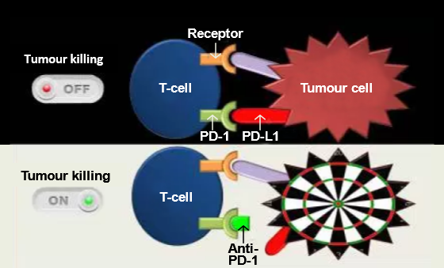
Latest Advances
27/35
Mechanism of action of immune
checkpoint inhibitors²
Immune checkpoint inhibitors¹
Target immune checkpoints that cancer cells use to avoid detection and elimination by immune cells
Examples
Programmed death-1 (PD-1) inhibitors: pembrolizumab and nivolumab
Cytotoxic T-lymphocyte-associated protein 4 (CTLA-4) inhibitor: ipilimumab
Angiogenesis inhibitors¹
Target the growth of new blood vessels
Several candidates in development
Anti-PD-1, anti-programmed death-1; PD-1, programmed death-1.
Adapted from Collins, 2016²
http://www.cancer.org/acs/groups/cid/documents/webcontent/003134-pdf.pdf. Accessed April 4, 2016.
https://directorsblog.nih.gov/2015/06/09/a-surprising-match-cancer-immunotherapy-and-mismatch-repair/. Accessed May 6, 2016.
Notes:
Latest advances
An important aspect of the immune system is its ability to target foreign harmful cells while avoiding normal cells in the body. The immune system utilises ‘checkpoints’ or protein molecules on immune cells, which turns on or off, in order to initiate an immune response. Cancer cells bind to these checkpoint proteins to turn off the immune cells. Drugs that can block these checkpoints and prevent tumour cells from turning off the immune response are currently in development. Examples of agents in development include programmed death-1 (PD-1) inhibitors pembrolizumab and nivolumab and cytotoxic T-lymphocyte-associated protein 4 (CTLA-4) inhibitor ipilimumab.¹ /p82/para4-7
Angiogenesis inhibitors belong to the category of targeted therapy drugs. These inhibitors target the growth of new blood vessels (angiogenesis) that would normally supply tumours with the nutrients they require to grow. Several potential candidates are in development.¹ /p82/para8-9
Reference:
Prostate cancer. American Cancer Society Web site. http://www.cancer.org/acs/groups/cid/documents/webcontent/003134-pdf.pdf. Accessed April 4, 2016.

Slide 41
Knowledge Check (2)
28/35
Fill in the blank:
Watchful waiting is an option in patients with a life expectancy ______ years.
> 10
<10
> 5
< 20
< 10
Notes:
Knowledge check (2)
Fill in the blank:
Watchful waiting is an option in patients with a life expectancy ______ years.
> 10
< 10
> 5
< 20
Answer: 2. Watchful waiting is an option in patients with a life expectancy < 10 years.

Slide 42
Knowledge Check (3)
29/35
Fill in the blank:
Active surveillance is an option in patients with a/an _________ risk for prostate cancer.
Intermediate
High
Low
Very high
Low
Notes:
Knowledge check (3)
Fill in the blank:
Active surveillance is an option in patients with a/an _________ risk for prostate cancer.
Intermediate
High
Low
Very high
Answer: 3. Active surveillance is an option in patients with a low risk for prostate cancer.

Slide 43
Knowledge Check (4)
30/35
Which of the following procedures is/are a part of radical prostatectomy?
Transurethral resection
LND
Resection of seminal vesicles
Removal of testes
Resection of seminal vesicles
LND, lymph node dissection.
Notes:
Knowledge check (4)
Which of the following procedures is/are a part of radical prostatectomy?
Transurethral resection
LND
Resection of seminal vesicles
Removal of testes
Answer: 3. Resection of seminal vesicles is a part of radical prostatectomy.
LND, lymph node dissection.

Slide 44
Knowledge Check (5)
31/35
Which of the following class of drugs causes a testosterone ‘flare’ when first administered?
LHRH antagonists
Androgen synthesis inhibitors
LHRH agonists
Antiandrogens
LHRH agonists
LHRH, luteinising hormone-releasing hormone.
Notes:
Knowledge check (5)
Which of the following class of drugs causes a testosterone ‘flare’ when first administered?
LHRH antagonists
Androgen synthesis inhibitors
LHRH agonists
Antiandrogens
Answer: 3. LHRH agonists cause a testosterone ‘flare’ when first administered.
LHRH, luteinising hormone-releasing hormone.

Slide 45
Knowledge Check (6)
32/35
Which of the following are not side effects of androgen deprivation therapy?
Impotence
Metabolic syndrome
Urinary incontinence
Depression
Cardiotoxicity
Menstruation
Osteoporosis
Gastrointestinal cancer
Urinary incontinence
Menstruation
8. Gastrointestinal cancer
Notes:
Knowledge check (6)
Which of the following are not side effects of androgen deprivation therapy?
Impotence
Metabolic syndrome
Urinary incontinence
Depression
Cardiotoxicity
Menstruation
Osteoporosis
Gastrointestinal cancer
Answer: 3, 6 and 8. Urinary incontinence, menstruation and gastrointestinal cancer are not side effects of androgen deprivation therapy.

Slide 46


Knowledge Check (7)
33/35
Match the drug class in column A with its properties in column B.
Column A | Column B
1. LHRH agonists | Inhibits AR nuclear translocation
2. LHRH antagonists | Used in conjunction with prednisone
3. CYP450 inhibitors | Decreases LH, FSH and testosterone levels
4. Antiandrogens | Increases LH, FSH and testosterone levels
Column A | Column B
1. LHRH agonists | Increases LH, FSH and testosterone levels
2. LHRH antagonists | Decreases LH, FSH and testosterone levels
3. CYP450 inhibitors | Used in conjunction with prednisone
4. Antiandrogens | Inhibits AR nuclear translocation
AR, androgen receptor; CYP450, cytochrome P450; FSH, follicle-stimulating hormone; LH, luteinising hormone; LHRH, luteinising hormone-releasing hormone.
Notes:
Knowledge check (7)
Match the drug class in column A with its properties in column B.
Column A
LHRH agonists
LHRH antagonists
CYP450 inhibitors
Antiandrogens
Column B
Inhibits AR nuclear translocation
Used in conjunction with prednisone
Decreases LH, FSH and testosterone levels
Increases LH, FSH and testosterone levels
Answer:
d.
c.
b.
a.
AR, androgen receptor; CYP450, cytochrome P450; FSH, follicle-stimulating hormone; LH, luteinising hormone; LHRH, luteinising hormone-releasing hormone.

Slide 47
Knowledge Check (8)
34/35
Match the type of therapy in column A with therapy features in column B.
Column A | Column B
IAD | Decreases treatment costs
CAB | Increases side effects
Radiation therapy + ADT | Standard treatment for locally advanced prostate cancer as per EAU guidelines
Column A | Column B
IAD | Less effective than medical or surgical castration monotherapy
CAB | Standard treatment for locally advanced prostate cancer as per EAU guidelines
Radiation therapy + ADT | Decreases treatment costs
Less effective than medical or surgical castration monotherapy
Increases side effects
NSAA monotherapy
NSAA monotherapy
ADT, androgen deprivation therapy; CAB, complete androgen blockade; EAU, European Association of Urology; IAD, intermittent androgen deprivation; NSAA, nonsteroidal antiandrogen.
Notes:
Knowledge check (8)
Match the type of therapy in column A with therapy features in column B.
Column A
IAD
CAB
Radiation therapy + ADT
NSAA monotherapy
Column B
Less effective than medical or surgical castration monotherapy
Standard treatment for locally advanced prostate cancer as per EAU guidelines
Decreases treatment costs
Increases side effects
Answer:
c.
d.
b.
a.
ADT, androgen deprivation therapy; CAB, complete androgen blockade; EAU, European Association of Urology; IAD, intermittent androgen deprivation; NSAA, nonsteroidal antiandrogen.

Slide 48
Knowledge Check (9)
35/35
Match the treatments in column A with their descriptions in column B.
Column A | Column B
Cryosurgery | Utilises freezing techniques to induce cell death
HIFU | Utilises ultrasound waves to damage tissue
Angiogenesis inhibitors | Targets the growth of new blood vessels
PD-1 inhibitors | Targets immune checkpoints
Column A | Column B
Cryosurgery | Targets immune checkpoints
HIFU | Targets the growth of new blood vessels
Angiogenesis inhibitors | Utilises freezing techniques to induce cell death
PD-1 inhibitors | Utilises ultrasound waves to damage tissue
HIFU, high-intensity focussed ultrasound; PD-1, programmed death-1.
Notes:
Knowledge check (9)
Match the treatments in column A with their descriptions in column B.
Column A
Cryosurgery
HIFU
Angiogenesis inhibitors
PD-1 inhibitors
Column B
Targets immune checkpoints
Targets the growth of new blood vessels
Utilises freezing techniques to induce cell death
Utilises ultrasound waves to damage tissue
Answer:
c.
d.
b.
a.
HIFU, high-intensity focussed ultrasound; PD-1, programmed death-1.

Slide 49
Prostate Cancer Staging and Risk Stratification

Slide 50
EAU Guidelines for Prostate Cancer Staging
1/5
Guidelines for staging of prostate cancer¹
Prostate cancer stage
Any risk group staging
Low-risk localised prostate cancer
Intermediate-risk prostate cancer
High-risk localised prostate cancer/high-risk locally advanced prostate cancer
Guidelines
Additional imaging if patient management changed
CT/TRUS not to be used for local staging
PET-scan not to be used for up-front staging
Guidelines
No additional imaging
Guidelines
Bone scan
Cross-sectional imaging
Guidelines
Prostate mpMRI for local staging
CT/MRI and bone scan for up-front staging
PET-scan not to be used for up-front staging
CT, computed tomography; mpMRI, multiparametric magnetic resonance imaging; PET, positron emission tomography; TRUS, transrectal ultrasound.
Adapted from Mottet, 2015¹
http://uroweb.org/wp-content/uploads/09-Prostate-Cancer_LR.pdf. Accessed April 8, 2016.
Notes:
EAU guidelines for prostate cancer staging
After evaluation by DRE and PSA, if there is need to further assess the extent of spread of prostate cancer, imaging techniques may be used. These include bone scanning, computed tomography (CT) scan, magnetic resonance imaging (MRI) or multiparametric MRI (mpMRI) to determine the extent of prostate cancer.¹ /p27/para5, /p30/Table5.3.5 Primarily, worldwide, the tumour, node, metastasis (TNM) system is used for staging.¹ /p18/Table4.1.2
Reference:
Mottet N, Bellmunt J, Briers E, et al. Guidelines on prostate cancer. European Association of Urology Web site. http://uroweb.org/wp-content/uploads/09-Prostate-Cancer_LR.pdf. Accessed April 8, 2016.

Slide 51
Prostate Cancer Staging: Tumour, Node, Metastasis Classification
2/5
TNM classification of prostate cancer¹
Primary tumour (T)
TX | Primary tumour cannot be assessed
T0 | No evidence of primary tumour
T1 | Clinically unapparent tumour not palpable or visible on imaging T1a: Histological finding in ≤ 5% of resected tissue T1b: Histological finding in > 5% of resected tissue T1c: Tumour identified by needle biopsy
T2 | Tumour confined within prostate T2a: Tumour involves ≤ 50% of one lobe T2b: Tumour involves > 50% of one lobe T2c: Tumour involves both lobes
T3 | Tumour extends through the prostatic capsule T3a: Extracapsular extension (unilateral or bilateral) including microscopic bladder neck involvement T3b: Tumour invades seminal vesicle(s)
T4 | Tumour is fixed or invades adjacent structures other than seminal vesicle
Regional lymph nodes (N)
NX | Regional lymph nodes cannot be assessed
N0 | No regional lymph node metastasis
N1 | Regional lymph node metastasis
Distant metastasis (M)
MX | Distant metastases cannot be assessed
M0 | No distant metastases
M1 | Distant metastases M1a: Non-regional lymph node(s) M1b: Bone(s) M1c: Other site(s)
TNM, tumour, node, metastasis.
Adapted from Mottet, 2015¹
http://uroweb.org/wp-content/uploads/09-Prostate-Cancer_LR.pdf. Accessed April 8, 2016.
Notes:
Prostate cancer staging: Tumour, node, metastasis classification
The current internationally accepted classification system is the TNM staging system. This system indicates the extent of the local disease (T), the status of the regional lymph nodes (N) and spread of the disease to distant organs or lymph nodes (M).¹ /p18/Table4.1.1
Tumour staging is as follows:
Stage TX: Primary tumour cannot be assessed
Stage T0: No evidence of primary tumour
Stages T1-2c: Disease confined to the prostate
Stage T3a: Extracapsular extension of the tumour
Stage T3b: Invasion of the seminal vesicles
Stage T4: Invasion of adjacent structures other than the seminal vesicle, such as the bladder neck, external sphincter, rectum and/or pelvic floor.
Lymph node involvement staging is as follows:
Stage NX: Regional lymph nodes cannot be assessed
Stage N0: No regional lymph node metastasis
Stage N1: Regional lymph node(s) metastasis
Distant metastatic involvement staging is as follows:
Stage MX: Distant metastases cannot be assessed
Stage M0: No distant metastases
Stage M1: Distant metastases
Stage M1a: Distant metastases other than regional lymph nodes
Stage M1b: Metastasis to bone(s)
Stage M1c: Metastasis to other site(s)
Prostate cancer can be differentiated into 4 stages. In stage I, cancer remains confined to the prostate only. In stage II, cancer becomes more advanced compared to stage I, but remains confined to the prostate gland. In stage III, the cancer spreads outside the prostate gland and may also invade the seminal vesicles. In stage IV, cancer spread to the surrounding tissues such as the rectum, bladder or pelvic wall.² /p4/para1 and 2, /p5/para3 and 4
References:
Mottet N, Bellmunt J, Briers E, et al. Guidelines on prostate cancer. European Association of Urology Web site. http://uroweb.org/wp-content/uploads/09-Prostate-Cancer_LR.pdf. Accessed April 8, 2016.
Prostate cancer treatment (PDQ®)–patient version. National Cancer Institute Web site. http://www.cancer.gov/types/prostate/patient/prostate-treatment-pdq#section/_120. Accessed May 26, 2016.

Slide 52
Risk Stratification by D’Amico Classification
3/5
EAU risk groups for biochemical recurrence of localised and locally advanced prostate cancer¹
 | Low risk | Intermediate risk | High risk
Definition | PSA < 10 ng/mL GS < 7 cT1-2a | PSA 10-20 ng/mL GS 7 cT2b | PSA > 20 ng/mL GS > 7 cT2c | Any PSA Any GS cT3-4 or cN+
 | Localised |  |  | Locally advanced
Adapted from Mottet, 2016¹
GS, Gleason score; PSA, prostate-specific antigen.
Stratification based on¹:
Serum PSA value
Biopsy score (Gleason scores)
Clinical stage
https://uroweb.org/guideline/prostate-cancer/#4. Accessed April 7, 2016.
Notes:
Risk stratification by D’Amico classification
Another way to classify prostate cancer is using the D’Amico’s classification system.¹ /p6/Table4.2.2 This classification is done by grouping patients with a similar risk of biochemical recurrence after surgery or radiation.¹ /p2/para1, /p3/para1
Reference:
Mottet N, Bellmunt J, Briers E. et al. EAU Prostate Cancer guidelines. European Association of Urology Web site. https://uroweb.org/guideline/prostate-cancer/#4. Accessed April 7, 2016.

Slide 53
NCCN Guidelines For Risk Stratification
NCCN risk groups for biochemical recurrence of localised,
locally advanced and metastatic prostate cancer¹
4/5
Stage of prostate cancer | Recurrence risk | Definition
Localised | Very low risk | • PSA < 10 ng/mL • GS ≤ 6 • Fewer than 3 prostate biopsy • T1c cores positive, ≤ 50% cancer in • PSA density < 0.15 ng/mL/g any core
 | Low risk | • PSA < 10 ng/mL • T1-T2a GS ≤ 6
 | Intermediate risk | • PSA 10-20 ng/mL • T2b-2c • GS 7
 | High risk | • PSA > 20 ng/mL • T3a • GS 8-10
Locally advanced | Very high risk | • Primary Gleason pattern 5 • T3b-T4 • > 4 cores with Gleason score 8-10
Metastatic |  | Any T, N1 Any T, any N, M1
GS, Gleason score; PSA, prostate-specific antigen.
Adapted from NCCN Guidelines, 2016¹
Coit DG, et al. J Natl Compr Canc Netw. 2016;14(4):450-473.
Notes:
NCCN guidelines for risk stratification
The NCCN guidelines classification of patients is similar to the D’Amico classification system. Besides grouping patients according to the probability of biochemical recurrence (low, intermediate and high risk) following surgery or radiation therapy, additional groups include patients with a very-low recurrence risk and those with a very-high recurrence risk of prostate cancer. The latter patients are those with locally advanced disease.¹ /p7
Reference:
Coit DG, Thompson JA, Algazi A, et al. Melanoma, version 2.2016, NCCN clinical practice guidelines in oncology. J Natl Compr Canc Netw. 2016;14(4):450-473. https://www.nccn.org/professionals/physician_gls/pdf/prostate.pdf. Accessed June 16, 2016.

Slide 54
Knowledge Check (10)
5/5
Based on NCCN guidelines, match the type of recurrence-risk in column A with its associated criteria in column B.
Column A | Column B
1. Very low risk | a. PSA 10-20 ng/mL, GS 7, T2b-2c
2. Low risk | b. PSA >20 ng/mL, GS 8-10, T3a
3. Intermediate risk | c. PSA <10 ng/mL, GS ≤6, T1c
4. High risk | d. PSA <10 ng/mL, GS ≤6, T1-T2a
Column A | Column B
1. Very low risk | c. PSA < 10 ng/mL, GS ≤ 6, T1c
2. Low risk | d. PSA < 10 ng/mL, GS ≤ 6, T1-T2a
3. Intermediate risk | a. PSA 10-20 ng/mL, GS 7, T2b-2c
4. High risk | b. PSA > 20 ng/mL, GS 8-10, T3a
GS, Gleason score; NCCN, National Comprehensive Cancer Network; PSA, prostate-specific antigen.
53
| For internal training purpose only.
Notes:
Knowledge check (10)
Based on NCCN guidelines, match the type of recurrence-risk in column A with its associated criteria in column B.
Column A
Very low risk
Low risk
Intermediate risk
High risk
Column B
PSA 10-20 ng/mL, GS 7, T2b-2c
PSA > 20 ng/mL, GS 8-10, T3a
PSA < 10 ng/mL, GS ≤ 6, T1c
PSA < 10 ng/mL, GS ≤ 6, T1-T2a
Answer:
c.
d.
a.
b.
GS, Gleason score; NCCN, National Comprehensive Cancer Network; PSA, prostate-specific antigen.

Slide 55
Treatment Continuum and Treatment Guidelines

Slide 56
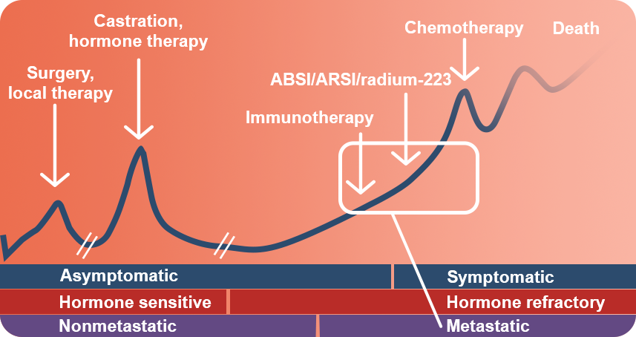
Treatment Continuum: Prostate Cancer
1/16
Androgen-sensitive stages¹
Localised disease Nonmetastatic biochemical relapse Metastatic hormone-sensitive disease
1/20
Castration-resistant stages¹
Nonmetastatic
Metastatic asymptomatic
Metastatic symptomatic
Treatment continuum for prostate cancer¹
Time
Minimally symptomatic mCRPC
Tumour volume
Adapted from Shore, 2016¹
ABSI, androgen biosynthesis inhibitor; ARSI, androgen receptor signalling inhibitor; mCRPC, metastatic castration-resistant prostate cancer.
http://education.goldjournal.net/video.php?event_id=649&stage_id=5&vcs=1. Accessed May 13, 2016.
Notes:
Treatment continuum: Prostate cancer
Prostate cancer stages range from androgen-sensitive to castration-resistant.¹ /p2 Androgen-sensitive stages include newly diagnosed localised disease, nonmetastatic biochemical relapse and metastatic hormone-sensitive disease.¹ /p2 Based on the guidelines outlined by the EAU, the ESMO and NCCN, the physician in conjunction with the patient is faced with many choices.²⁻⁴ Additionally, nomograms may be consulted to arrive at the right treatment decision for a specific patient.⁵ /p2/para1
References:
Shore ND. Advances in treating mCRPC: Focus on combining and sequencing therapies. Application of new therapeutic agents in mCRPC after failure of androgen-deprivation therapy (Media). Urology Gold Journal Web site. http://education.goldjournal.net/video.php?event_id=649&stage_id=5&vcs=1. Accessed May 13, 2016.
Mottet N, Bellmunt J, Briers E, et al. Guidelines on prostate cancer. European Association of Urology Web site. http://uroweb.org/wp-content/uploads/09-Prostate-Cancer_LR.pdf. Accessed April 8, 2016.
Parker C, Gillessen S, Heidenreich A, ESMO Guidelines Committee. Cancer of the prostate: ESMO clinical practice guidelines for diagnosis, treatment, and follow-up. Ann Oncol. 2015;26(Suppl 5):v69-v77. doi:10.1093/annonc/mdv222.
Coit DG, Thompson JA, Algazi A, et al. Melanoma, version 2.2016, NCCN clinical practice guidelines in oncology. J Natl Compr Canc Netw. 2016;14(4):450-473. https://www.nccn.org/professionals/physician_gls/pdf/prostate.pdf. Accessed June 16, 2016.
Shariat SF, Kattan MW, Vickers AJ, Karakiewicz PI, Scardino PT. Critical review of prostate cancer predictive tools. Future Oncol. 2009;5(10):1555-1584. doi:10.2217/fon.09.121.

Slide 57
Treatment Continuum: Prostate Cancer (cont.)
1/16
2/20
Treatment for androgen-sensitive stages¹⁻³
Very low risk and low risk
Radical prostatectomy
Radiation therapy
Intermediate risk (as for low risk)
Neoadjuvant or concomitant ADT with radiotherapy
ADT monotherapy in symptomatic patients
High risk
Short-term or long-term adjuvant or neoadjuvant ADT + radiation
ADT + radiation + chemotherapy
Radiation with adjuvant and neoadjuvant ADT
Treatment for castration-resistant prostate cancer stages⁴
Immunotherapy (sipuleucel-T): In asymptomatic patients
CYP450 inhibitors (abiraterone):In patients before and after chemotherapy
Antiandrogens (enzalutamide): In patients who have already received docetaxel
Bone-directed treatments: In patients with bone metastases
Chemotherapy
Coit DG, et al. J Natl Compr Canc Netw. 2016;14(4):450-473.
Parker C, et al. Ann Oncol. 2015;26(Suppl 5):v69-v77.
http://uroweb.org/wp-content/uploads/09-Prostate-Cancer_LR.pdf. Accessed April 8, 2016.
http://education.goldjournal.net/video.php?event_id=649&stage_id=5&vcs=1. Accessed May 13, 2016.
Notes:
Treatment continuum: Prostate cancer (cont.)
The treatment options for the early stages (very low-risk and low-risk localised) of prostate cancer when the patient is still hormone-sensitive include radical prostatectomy and radiation therapy. As the cancer progresses to the intermediate-risk localised stage, neoadjuvant or concomitant ADT is introduced along with radiotherapy, or in symptomatic patients, ADT monotherapy. For high-risk cancers, short-term or long-term adjuvant or neoadjuvant ADT along with radiation, or ADT with radiation and chemotherapy, or radiation with adjuvant and neoadjuvant ADT are all acceptable choices.¹⁻³ /p8-11 /pv71/Table3, /pv70/col2/para2-3, /p76-77/Table6.9
New options available to treat castration-resistant prostate cancer patients include sipuleucel-T (immunotherapy) for asymptomatic patients, CYP450 inhibitor abiraterone that can be given with prednisone before and after chemotherapy or the antiandrogen enzalutamide that is indicated for patients who have already received docetaxel. Radioisotopes, such as radium-223 can be administered before or after chemotherapy.⁴ /p2/para1-4 Finally, treatments with bisphosphonates or denosumab may be used for bone metastases, before, during and after chemotherapy.⁴ /p3/para1
The next slides provide detailed information on the NCCN, ESMO and EAU guidelines. First, let us look at the guidelines for treatment of localised prostate cancer.
References:
Mottet N, Bellmunt J, Briers E, et al. Guidelines on prostate cancer. European Association of Urology Web site. http://uroweb.org/wp-content/uploads/09-Prostate-Cancer_LR.pdf. Accessed April 8, 2016.
Parker C, Gillessen S, Heidenreich A, ESMO Guidelines Committee. Cancer of the prostate: ESMO clinical practice guidelines for diagnosis, treatment, and follow-up. Ann Oncol. 2015;26(Suppl 5):v69-v77. doi:10.1093/annonc/mdv222.
Coit DG, Thompson JA, Algazi A, et al. Melanoma, version 2.2016, NCCN clinical practice guidelines in oncology. J Natl Compr Canc Netw. 2016;14(4):450-473. https://www.nccn.org/professionals/physician_gls/pdf/prostate.pdf. Accessed June 16, 2016.
Shore ND. Advances in treating mCRPC: Focus on combining and sequencing therapies. Application of new therapeutic agents in mCRPC after failure of androgen-deprivation therapy (Media). Urology Gold Journal Web site. http://education.goldjournal.net/video.php?event_id=649&stage_id=5&vcs=1. Accessed May 13, 2016.

Slide 58
NCCN Guidelines: Localised Treatment
3/20
Treatment options for various risk groups¹
Recurrence risk | Treatment options
Very low risk | Observation (if expected patient survival is < 10 years) Active surveillance EBRT or LDR brachytherapy Radical prostatectomy ± PLND (if metastasis probability is ≥ 2%)
Low risk | Observation (if expected patient survival is < 10 years) Active surveillance EBRT or LDR brachytherapy Radical prostatectomy ± PLND (if metastasis probability is ≥ 2%)
Adjuvant therapy for all risk categories: EBRT or observation or ADT ± EBRT
ADT, androgen deprivation therapy; EBRT, external beam radiotherapy; LDR, low-dose rate; PLND, pelvic lymph node dissection.
Adapted from NCCN Guidelines, 2016¹
Coit DG, et al. J Natl Compr Canc Netw. 2016;14(4):450-473.
Notes:
NCCN guidelines: Localised treatment
The NCCN clinical practice guidelines for prostate cancer group localised disease is tailored in relation to recurrence risk and treatment. For very low-risk and low-risk patients, radiation therapy (EBRT or LDR brachytherapy) or radical prostatectomy (with or without PLND) is recommended.¹ /p8-11
Reference:
Coit DG, Thompson JA, Algazi A, et al. Melanoma, version 2.2016, NCCN clinical practice guidelines in oncology. J Natl Compr Canc Netw. 2016;14(4):450-473. https://www.nccn.org/professionals/physician_gls/pdf/prostate.pdf. Accessed June 16, 2016.

Slide 59
NCCN Guidelines: Localised Treatment (cont.)
4/20
Treatment options for various risk groups¹ (cont.)
Recurrence risk | Treatment options
Intermediate risk | EBRT ± short-term (neo)adjuvant/concomitant ADT ± LDR brachytherapy LDR brachytherapy Radical prostatectomy + PLND (if metastasis probability is ≥ 2%) Observation
High risk | EBRT + long-term (neo)adjuvant/concomitant ADT EBRT + LDR ± short-term (neo)adjuvant/concomitant ADT Radical prostatectomy + PLND EBRT + ADT + docetaxel
Adjuvant therapy for all risk categories: EBRT or observation or ADT ± EBRT
Very high risk
Same as high risk
ADT in patients not candidates for definitive therapy
ADT, androgen deprivation therapy; EBRT, external beam radiotherapy; LDR, low-dose rate; PLND, pelvic lymph node dissection.
Adapted from NCCN Guidelines, 2016¹
Coit DG, et al. J Natl Compr Canc Netw. 2016;14(4):450-473.
Notes:
NCCN guidelines: Localised treatment (cont.)
The NCCN clinical practice guidelines recommend that intermediate patients may additionally be given ADT (short-term neoadjuvant or adjuvant) with radiation, LDR brachytherapy monotherapy, or radical prostatectomy with PLND. High-risk patients may receive radiation therapy (EBRT) with long-term adjuvant or neoadjuvant ADT, or EBRT with LDR brachytherapy and short-term adjuvant or neoadjuvant ADT. Similar to the other risk categories, radical prostatectomy with PLND is an option. An additional recommendation for high-risk patients is EBRT along with ADT and chemotherapy (docetaxel). Treatment for very high-risk patients is along similar lines to that for high-risk patients. ADT may be given to these patients if they are not candidates for definitive therapy.¹ /p8-11
Reference:
Coit DG, Thompson JA, Algazi A, et al. Melanoma, version 2.2016, NCCN clinical practice guidelines in oncology. J Natl Compr Canc Netw. 2016;14(4):450-473. https://www.nccn.org/professionals/physician_gls/pdf/prostate.pdf. Accessed June 16, 2016.

Slide 60
ESMO Guidelines: Localised Treatment
5/20
Treatment options for localised prostate cancer¹
Recurrence risk | Treatment optionsª
Low risk | Active surveillance Brachytherapy Radical prostatectomy Radical radiotherapy Watchful waiting in patients who are unwilling or unsuited for radical treatment
Intermediate risk | Active surveillance Brachytherapy Radical prostatectomy Radical radiotherapy ± neoadjuvant ADT
High risk | Neoadjuvant ADT + radical radiotherapy + adjuvant ADT Radical prostatectomy + pelvic lymphadenectomy
ªOptions listed in alphabetical order
ADT, androgen deprivation therapy.
Adapted from Parker, 2015¹
Parker C, et al. Ann Oncol. 2015;26(Suppl 5):v69-v77.
Notes:
ESMO guidelines: Localised treatment
The ESMO provides guidelines for the therapeutic management of different stages of prostate cancer. As with the NCCN guidelines, the ESMO prostate cancer clinical practice guidelines for localised disease are also grouped in relation to recurrence risk. Recommendations include watchful waiting with delayed hormone therapy for patients with low-risk disease and those with localised disease who are not suited or unwilling to have radical treatment. Radical prostatectomy or radiotherapy including external beam or brachytherapy are options for patients with low- or intermediate-risk disease. EBRT in combination with hormonal therapy or radical prostatectomy with pelvic lymphadenectomy are options for patients with high-risk cancer.¹ /pv70/col2/para2-3, /pv71/Table3
Reference:
Parker C, Gillessen S, Heidenreich A, Horwich A, ESMO Guidelines Committee. Cancer of the prostate: ESMO clinical practice guidelines for diagnosis, treatment, and follow-up. Ann Oncol. 2015;26(Suppl 5):v69-v77. doi:10.1093/annonc/mdv222.

Slide 61
EAU Guidelines: Localised Treatment
6/20
Primary treatment guidelines for prostate cancer¹
Recurrence risk | Treatment guidelines
Low risk | Watchful waiting Active surveillance Radical prostatectomy Radiotherapy Cryosurgery, HIFU
Intermediate risk | Watchful waiting Radical prostatectomy (in patients with life expectancy > 10 years) Radiotherapy (total dose 76-78 Gy in combination with short-term ADT) Androgen suppression monotherapy (symptomatic patients only)
High risk | Watchful waiting Radical prostatectomy (in patients with life expectancy > 10 years) Radiotherapy (total dose 76-78 Gy in combination with long-term ADT) Androgen suppression (asymptomatic and symptomatic patients unable/unwilling to receive any form of local treatment)
Patients suitable for several treatment strategies must have these options discussed with them. All surgical approaches (open, laparoscopic or robotic) are acceptable for radical prostatectomy. EBRT should be offered in all risk groups of nonmetastatic prostate cancer.
ADT, androgen deprivation therapy; EBRT, external beam radiation therapy; HIFU, high-intensity focussed ultrasound.
Adapted from Mottet, 2015¹
http://uroweb.org/wp-content/uploads/09-Prostate-Cancer_LR.pdf. Accessed April 8, 2016.
Notes:
EAU guidelines: Localised treatment
Watchful waiting is an option in patients with low-risk, intermediate-risk and high-risk localised prostate cancer not eligible for curative treatments and those with a short life expectancy. These patients should receive non-curative treatments based on symptoms and disease progression.¹ /p76/Table6.9, /p77/Table6.9 Active surveillance is an option for patients with a life expectancy of greater than 10 years and the lowest risk of cancer progression. In this group, radical prostatectomy is an option. Patients at low risk may undergo radiotherapy, such as brachytherapy, with a total dose between 74 and 78 Gy. Those patients unsuited to these options can be treated with cryosurgery or HIFU. The EAU guidelines do not recommend focal therapy as an option outside clinical trials.¹ /p76/Table6.9, /p77/Table6.9
Options available to patients with intermediate-risk prostate and a life expectancy of greater than 10 years include radical prostatectomy. eLND should be performed in these patients if the risk for positive lymph nodes is greater than 5%. However, the EAU does not recommend limited lymph node dissection (LND). Androgen suppression monotherapy is not recommended for asymptomatic patients.¹ /p77/Table
Neoadjuvant hormone therapy (NHT) before radical prostatectomy is not advised. eLND is recommended while limited LND is not advised. The total dose of radiotherapy must be between 76 and 78 Gy in combination with long-term ADT, while androgen suppression monotherapy is reserved for symptomatic or asymptomatic patients unwilling or unable to receive any form of local treatment.¹ /p77/Table
Moving on, we will discuss guidelines for locally advanced and metastatic prostate cancer.
Reference:
Mottet N, Bellmunt J, Briers E, et al. Guidelines on prostate cancer. European Association of Urology Web site. http://uroweb.org/wp-content/uploads/09-Prostate-Cancer_LR.pdf. Accessed April 8, 2016.

Slide 62
NCCN Guidelines: Locally Advanced and Metastatic Prostate Cancer
7/20
Treatment strategies for prostate cancer¹
Disease state | Treatment strategies
Locally advanced disease treatment (any T, N1, M0) | EBRT + ADT ADT
Metastatic disease treatment (any T, N, M1) | ADT (gold standard)
Radical prostatectomy biochemical failure | EBRT ± ADT Observation
Radiation therapy recurrence | First-line Radical prostatectomy + PLND Cryosurgery Brachytherapy Observation ADT Clinical trial
 | Second-line Cisplatin/etoposide Carboplatin/etoposide Docetaxel/carboplatin Clinical trial
ADT, androgen deprivation therapy; EBRT, external beam radiotherapy; PLND, pelvic lymph node dissection.
Adapted from NCCN Guidelines, 2016¹
Coit DG, et al. J Natl Compr Canc Netw. 2016;14(4):450-473.
Notes:
NCCN guidelines: Locally advanced and metastatic prostate cancer
NCCN guidelines recommend EBRT in combination with ADT or only ADT in patients with locally advanced disease.¹ /p11, /p13-15 ADT is the gold standard for treating metastatic disease.¹/p30 The guidelines outline treatment choices for recurrence following radical prostatectomy and radiation therapy. EBRT with or without ADT is recommended if recurrence occurs following radical prostatectomy. If recurrence occurs following radiation therapy, the first line of treatment includes radical prostatectomy with PLND. Cryosurgery, brachytherapy, ADT, participation in clinical trials are other choices available. Second-line treatments include combinations of cytotoxic agents such as cisplatin/etoposide, carboplatin/etoposide and docetaxel/carboplatin.¹ /p11, /p13-15
Reference:
Coit DG, Thompson JA, Algazi A, et al. Melanoma, version 2.2016, NCCN clinical practice guidelines in oncology. J Natl Compr Canc Netw. 2016;14(4):450-473. https://www.nccn.org/professionals/physician_gls/pdf/prostate.pdf. Accessed June 16, 2016.

Slide 63
ESMO Guidelines: Locally Advanced and Metastatic Prostate Cancer
8/20
Therapeutic strategies for locally advanced and metastatic prostate cancer¹
Disease state | Treatment strategies
Locally advanced disease treatment | Neoadjuvant ADT + radical radiotherapy + adjuvant ADT Radical prostatectomy + pelvic lymphadenectomy
Metastatic disease treatment | Continuous ADT as first-line treatment for hormone-naïve disease Patients to be informed that regular exercise during ADT treatment reduces fatigue and improves quality of life ADT + docetaxel recommended as first-line treatment for hormone-naïve disease in patients fit enough for chemotherapy
ADT, androgen deprivation therapy.
Adapted from Parker, 2015¹
Parker C, et al. Ann Oncol. 2015;26(Suppl 5):v69-v77.
Notes:
ESMO guidelines: Locally advanced and metastatic prostate cancer
ESMO guidelines recommend EBRT and ADT (neoadjuvant and adjuvant) or radical prostatectomy and pelvic lymphadenectomy for the treatment of locally advanced prostate cancer.¹ /pv71/col1/Table3, para2
The ESMO guidelines recommend continuous ADT as first-line treatment for metastatic hormone-naïve disease. For patients fit enough for chemotherapy, ADT along with docetaxel is the treatment of choice.¹ /pv71/col1/Table3, para2, /pv72/col2/para1
Reference:
Parker C, Gillessen S, Heidenreich A, Horwich A, ESMO Guidelines Committee. Cancer of the prostate: ESMO clinical practice guidelines for diagnosis, treatment, and follow-up. Ann Oncol. 2015;26(Suppl 5):v69-v77. doi:10.1093/annonc/mdv222.

Slide 64
EAU Guidelines: Locally Advanced Prostate Cancer
9/20
Primary treatment guidelines for locally advanced prostate cancer¹
Recurrence-risk of locally advanced disease | Treatment guidelines
High-risk prostate cancer | Watchful waiting Deferred ADT treatment policy in asymptomatic patients unwilling or unable to receive any form of local treatment Radical prostatectomy in selected patients (cT3b-T4 or any T N1) in a multimodality setting Adjuvant EBRT in above patients with an undetectable PSA following radical prostatectomy and patients informed about salvage irradiation when PSA increases Radiotherapy + long-term ADT in patients with cN0 prostate cancer
Cancer spreads to the regional lymph nodes (cN1) | Pelvic external irradiation in combination with immediate long-term ADT in patients with cN + prostate cancer
pN1 after eLND | Adjuvant ADT as the standard of care Adjuvant ADT + radiotherapy
ADT, androgen deprivation therapy; EBRT, external beam radiotherapy; eLND, extended lymph node dissection; pN1, immediate (adjuvant) postoperative external irradiation after radical prostatectomy; PSA, prostate-specific antigen.
Adapted from Mottet, 2015¹
http://uroweb.org/wp-content/uploads/09-Prostate-Cancer_LR.pdf. Accessed April 8, 2016.
Notes:
EAU guidelines: Locally advanced prostate cancer
The EAU guidelines recommend watchful waiting in patients with high-risk locally advanced prostate cancer (nonmetastatic), who are unwilling or unable to receive local treatment. In asymptomatic patients, deferred ADT monotherapy treatment may be offered.¹ /p77/Table, /p78/Table Other options include radical prostatectomy, adjuvant EBRT following radical prostatectomy and radiotherapy with long-term ADT.¹ /p77/Table, /p78
Adjuvant ADT is the standard of care for node-positive (pN+) patients.¹ /p77/Table, /p78
Reference:
Mottet N, Bellmunt J, Briers E, et al. Guidelines on prostate cancer. European Association of Urology Web site. http://uroweb.org/wp-content/uploads/09-Prostate-Cancer_LR.pdf. Accessed April 8, 2016.

Slide 65
EAU Guidelines: Metastatic Prostate Cancer
10/20
Primary treatment guidelines for metastatic prostate cancer¹
Metastatic disease treatment | Treatment guidelines
Watchful waiting | Only in asymptomatic patients Deferred castration to be discussed with a well-informed patient
Radical prostatectomy | Unsuitable outside clinical trial
Radiotherapy | Unsuitable outside clinical trial
Androgen suppression | Immediate surgical or medical castration (LHRH agonist or antagonist) to be offered to M1 asymptomatic and symptomatic patients Short-term antiandrogen treatment for M1 patients No antiandrogen monotherapy for M1 patients LHRH agonists + NSAA recommended
LHRH, luteinising hormone-releasing hormone; NSAA, nonsteroidal antiandrogens.
Adapted from Mottet, 2015¹
http://uroweb.org/wp-content/uploads/09-Prostate-Cancer_LR.pdf. Accessed April 8, 2016.
Notes:
EAU guidelines: Metastatic prostate cancer
The treatment options for metastatic disease include watchful waiting in asymptomatic patients, although deferred castration must be discussed with well-informed patients.¹ /p78/Table, /p79/Table Both radical prostatectomy and radiotherapy are unsuitable outside clinical trial settings. Immediate ADT is strongly recommended. The table outlines androgen suppression options in greater detail. Surgical or ADT (using LHRH agonists or antagonists) is the first option to be offered to M1 symptomatic and asymptomatic patients. While short-term antiandrogen treatment may be given, antiandrogen monotherapy is not recommended for M1 patients. Finally, a combination of LHRH agonists and NSAA treatment is recommended in patients with metastatic prostate cancer.¹ /p77/Table, /p78
Next up are guidelines for the treatment of castration-resistant prostate cancer.
Reference:
Mottet N, Bellmunt J, Briers E, et al. Guidelines on prostate cancer. European Association of Urology Web site. http://uroweb.org/wp-content/uploads/09-Prostate-Cancer_LR.pdf. Accessed April 8, 2016.

Slide 66
ESMO Guidelines: Castration-Resistant Prostate Cancer
11/20
ESMO guidelines for castration-resistant disease treatment¹
Disease state | Treatment guidelinesª
Castration-resistant (first-line) | Abiraterone, enzalutamide (for asymptomatic/mildly symptomatic patients) Docetaxel (symptomatic patients) Radium-223 (visceral metastasis)
Second-line (post-docetaxel) | Abiraterone, enzalutamide Cabazitaxel Radium-223 (no visceral metastasis)
ªOptions listed in alphabetical order
Adapted from Parker, 2015¹
Parker C, et al. Ann Oncol. 2015;26(Suppl 5):v69-v77.
Notes:
ESMO guidelines: Castration-resistant prostate cancer
ESMO guidelines recommend radium-223 for patients with symptomatic metastatic CRPC without visceral metastasis and with predominant bone involvement.¹ /pv71/col1/Table3, /pv73/col1/para1 Another option for chemotherapy-naïve asymptomatic patients is treatment with sipuleucel-T.¹ /pv73/col1/para1 For second-line treatment post docetaxel, the guidelines recommend abiraterone, enzalutamide, cabazitaxel and radium-223 (only when there are no visceral metastases).¹ /pv71/col1/Table3, /pv73/col1/para6
References:
Parker C, Gillessen S, Heidenreich A, Horwich A, ESMO Guidelines Committee. Cancer of the prostate: ESMO clinical practice guidelines for diagnosis, treatment, and follow-up. Ann Oncol. 2015;26(Suppl 5):v69-v77. doi:10.1093/annonc/mdv222.

Slide 67
NCCN Guidelines: Castration-Resistant Prostate Cancer
12/20
NCCN guidelines for M1 castration-resistant disease treatment¹
Disease state | Treatment guidelines
Castration-resistant (first-line) | Same as above plus Secondary hormone therapy Mitoxantrone
Second-line (post-docetaxel, no visceral metastases) | Same as above plus Vaccines Secondary hormone therapy Alternate chemotherapy
Second-line (post-enzalutamide/abiraterone, no visceral metastases) | Docetaxel with prednisone; abiraterone with prednisone; enzalutamide; radium-223; sipuleucel-T; clinical trial; other secondary hormone therapy (as above); best supportive care
Second-line (visceral metastases) | Same as above for second-line treatment minus sipuleucel-T and radium-223
DES, diethylstilboestrol.
Adapted from NCCN Guidelines, 2016¹
Coit DG, et al. J Natl Compr Canc Netw. 2016;14(4):450-473.
Notes:
NCCN guidelines: Castration-resistant prostate cancer
The NCCN recommendations are similar to the ESMO guidelines, but with the addition of secondary hormone therapy including antiandrogen, antiandrogen withdrawal, ketoconazole with or without hydrocortisone, corticosteroids and DES or other oestrogens. Another difference is the addition of alternative chemotherapy such as mitoxantrone as first-line treatment. For second-line treatment, the approach is similar to the ESMO guidelines, but includes vaccine therapy, secondary hormone therapy and alternate chemotherapy.² /p16-19
References:
Coit DG, Thompson JA, Algazi A, et al. Melanoma, version 2.2016, NCCN clinical practice guidelines in oncology. J Natl Compr Canc Netw. 2016;14(4):450-473. https://www.nccn.org/professionals/physician_gls/pdf/prostate.pdf. Accessed June 16, 2016.

Slide 68
EAU guidelines: Castration-Resistant Prostate Cancer
13/20
EAU guidelines for metastatic castration-resistant prostate cancer (mCRPC)¹
Disease state | Treatment guidelines
CRPC | Second-line therapy to be started only when serum testosterone levels are < 50 ng/dL Patients treated with maximal androgen blockade to stop antiandrogen treatment when PSA progression is documented Abiraterone acetate or enzalutamide to be used to salvage hormonal treatment
mCRPC | Patients suitable for chemotherapy: docetaxel at 75 mg/m² every 3 weeks First choice options after relapse following first-line docetaxel: cabazitaxel, abiraterone acetate and enzalutamide
Bone metastases | Symptomatic bone metastases (docetaxel-ineligible or docetaxel-relapsed patients) to be treated with Radium-223 Bone protective agents (denosumab superior to zoledronic acid) Vitamin D and calcium supplements when using denosumab or bisphosphonates Pain management using radionuclides, EBRT and analgesics Spinal surgery or high-dose corticosteroids for neurological symptoms
CRPC, castration-resistant prostate cancer; blockade; mCRPC, metastatic castration-resistant prostate cancer; PSA, prostate-specific antigen.
Adapted from Mottet, 2015¹
http://uroweb.org/wp-content/uploads/09-Prostate-Cancer_LR.pdf. Accessed April 8, 2016.
Notes:
EAU guidelines: Castration-resistant prostate cancer
EAU guidelines provide no definitive strategy regarding treatment choices in patients with mCRPC after hormone therapy. However, the guidelines state that second-line therapy should not be started until testosterone serum levels are less than 50 ng/dL and prostate serum levels are greater than 2 ng/mL (to ensure accurate interpretation of efficacy).¹ /p97/Table6.11.9
Patients suitable for chemotherapy should be administered docetaxel 75 mg/m² every 3 weeks, whereas patients with relapse after docetaxel should be offered cabazitaxel, abiraterone and enzalutamide as choices.¹ /p97/Table6.11.10
Nonspecific management of mCRPC is aimed at improving patient’s quality of life and reducing pain. The EAU recommends bone protective agents such as denosumab. Calcium and vitamin D supplements are also recommended when treating patients with denosumab or bisphosphonates.¹ /p97/Table6.11.11
Finally, there are certain considerations to keep in mind while treating the elderly population.
Reference:
Mottet N, Bellmunt J, Briers E, et al. Guidelines on prostate cancer. European Association of Urology Web site. http://uroweb.org/wp-content/uploads/09-Prostate-Cancer_LR.pdf. Accessed April 8, 2016.

Slide 69
Treatment Considerations for the Very Elderly
14/20
Guidelines for the treatment of senior adults (aged > 70 years)¹
Disease state | EAU treatment guidelines
Localised disease | Fit and vulnerable senior adults with life expectancy > 10 years and high-risk disease should be offered standard treatment. In frail or ‘too-sick’ patients, immediate ADT should only be used for symptom relief. Patients too-sick should receive symptomatic palliative treatment only. Minimally invasive energy-ablative therapies have a role in selected fit and vulnerable senior adults with intermediate-risk disease.
Advanced disease | Evaluation of bone mineral status and prevention of osteoporotic fracture are recommended in patients at high risk of fractures. New chemotherapeutic and hormonal agents can be used in fit and vulnerable adults.
ADT, androgen deprivation therapy.
Adapted from Mottet, 2015¹
http://uroweb.org/wp-content/uploads/09-Prostate-Cancer_LR.pdf. Accessed April 8, 2016.
Notes:
Treatment considerations for the very elderly
In case of localised disease, elderly patients with a life expectancy of greater than 10 years should be offered standard treatment. In frail or ‘too sick’ patients, immediate ADT should be used only for symptom relief. Palliative treatment is recommended for patients who are too sick. Active treatment is beneficial for patients with intermediate- and high-risk disease and those with a life expectancy of greater than 10 years.¹ /p80/Tables In case of advanced disease (metastatic hormone-naïve or castration-resistant metastatic disease), new chemotherapeutic and hormonal agents can be used in fit and vulnerable adults.¹ /p68/para7, /p69/para2, /p69/Table6.7.2.3
Reference:
Mottet N, Bellmunt J, Briers E, et al. Guidelines on prostate cancer. European Association of Urology Web site. http://uroweb.org/wp-content/uploads/09-Prostate-Cancer_LR.pdf. Accessed April 8, 2016.

Slide 70
Knowledge Check (11)
15/20
State whether the following statements are true or false.
EAU guidelines recommend IMRT as the gold standard for EBRT
NCCN guidelines recommend a combination of LDR brachytherapy and EBRT in patients with intermediate-risk cancer
Proton beam therapy is a type of brachytherapy
EBRT may be used to treat localised or locally advanced prostate cancer
TRUE
FALSE
FALSE
TRUE
EBRT, external beam radiation therapy; IMRT, intensity-modulated radiotherapy; LDR, low-dose rate; NCCN, National Comprehensive Cancer Network.
Notes:
Knowledge check (11)
State whether the following statements are true or false.
EAU guidelines recommend IMRT as the gold standard for EBRT
NCCN guidelines recommend a combination of LDR brachytherapy and EBRT in patients with intermediate-risk cancer
Proton beam therapy is a type of brachytherapy
EBRT may be used to treat localised or locally advanced prostate cancer
Answer:
True
False. NCCN guidelines recommend EBRT or LDR brachytherapy for treatment of patients with low-risk and very low-risk cancer.
False. Proton beam therapy is a type of EBRT.
True
EBRT, external beam radiation therapy; IMRT, intensity-modulated radiotherapy; LDR, low-dose rate; NCCN, National Comprehensive Cancer Network.

Slide 71
Knowledge Check (12)
16/20
What is the preferred second-line agent for treating mCRPC following a recurrence after docetaxel treatment?
Mitoxantrone
Ketoconazole
Cabazitaxel
Repeat docetaxel
Cabazitaxel
mCRPC, metastatic castration-resistant prostate cancer.
Notes:
Knowledge check (12)
What is the preferred second-line agent for treating mCRPC following a recurrence after docetaxel treatment?
Mitoxantrone
Ketoconazole
Cabazitaxel
Repeat docetaxel
Answer: 3. Cabazitaxel is the preferred second-line agent for treating mCRPC following a recurrence after docetaxel treatment.
mCRPC, metastatic castration-resistant prostate cancer.

Slide 72
Knowledge Check (13)
17/20
Fill in the blanks:
____________ is the gold standard for the treatment of metastatic prostate cancer according to the ___________ guidelines.
Radiotherapy and NCCN
ADT and EAU
Radical prostatectomy and ESMO
ADT and NCCN
ADT and NCCN
ADT, androgen deprivation therapy; EAU, European Association of Urology; ESMO, European Society for Medical Oncology; NCCN, National Comprehensive Cancer Network.
Notes:
Knowledge check (13)
Fill in the blanks:
____________ is the gold standard for the treatment of metastatic prostate cancer according to the ___________ guidelines.
Radiotherapy and NCCN
ADT and EAU
Radical prostatectomy and ESMO
ADT and NCCN
Answer: 4. ADT is the gold standard for the treatment of metastatic prostate cancer according to the NCCN guidelines.
ADT, androgen deprivation therapy; EAU, European Association of Urology; ESMO, European Society for Medical Oncology; NCCN, National Comprehensive Cancer Network.

Slide 73
Knowledge Check (14)
18/20
State whether the following statements are true or false.
The EAU guidelines recommend the use of minimally invasive energy-ablative therapies in senior adults.
The NCCN guidelines recommend treatment with abiraterone, enzalutamide, cabazitaxel and radium-223 after docetaxel, in patients with no visceral metastases.
The EAU guidelines recommend calcium and vitamin D supplements along with bisphosphonates and denosumab.
The ESMO guidelines recommend treatment with sipuleucel-T as an option for chemotherapy-naïve symptomatic patients with CRPC.
FALSE
TRUE
TRUE
FALSE
CRPC, castration-resistant prostate cancer; EAU, European Association of Urology; ESMO, European Society for Medical Oncology; NCCN, National Comprehensive Cancer Network.
Notes:
Knowledge check (14)
State whether the following statements are true or false.
The EAU guidelines recommend the use of minimally invasive energy-ablative therapies in senior adults.
The NCCN guidelines recommend treatment with abiraterone, enzalutamide, cabazitaxel and radium-223 after docetaxel, in patients with no visceral metastases.
The EAU guidelines recommend calcium and vitamin D supplements along with bisphosphonates and denosumab.
The ESMO guidelines recommend treatment with sipuleucel-T as an option for chemotherapy-naïve symptomatic patients with CRPC.
Answer:
False. The EAU guidelines recommend minimally invasive energy-ablative therapies only in selected fit and vulnerable senior adults with intermediate-risk disease.
True
True
False. The ESMO guidelines recommend treatment with sipuleucel-T as an option for chemotherapy-naïve asymptomatic patients with CRPC.
CRPC, castration-resistant prostate cancer; EAU, European Association of Urology; ESMO, European Society for Medical Oncology; NCCN, National Comprehensive Cancer Network.

Slide 74
Knowledge Check (15)
19/20
Fill in the blank:
As per the EAU guidelines, the recommended dose for external beam radiotherapy in combination with short-term ADT is ___________.
76-78 Gy
75.6-79.2 Gy
40-50 Gy
90-100 Gy
76-78 Gy
ADT, androgen deprivation therapy; EAU, European Association of Urology.
Notes:
Knowledge check (15)
Fill in the blank:
As per the EAU guidelines, the recommended dose for external beam radiotherapy in combination with short-term ADT is ___________.
76-78 Gy
75.6-79.2 Gy
40-50 Gy
90-100 Gy
Answer: 1. As per the EAU guidelines, the recommended external beam radiotherapy dose for combination with short-term ADT is 76-78 Gy.
ADT, androgen deprivation therapy; EAU, European Association of Urology.

Slide 75
Knowledge Check (16)
20/20
State whether the following statements are true or false.
Based on the EAU guidelines, immediate ADT (medical or surgical castration) must be offered to M1 metastatic prostate cancer patients who are asymptomatic or symptomatic.
The EAU guidelines suggest that for bone metastases, zoledronic acid is superior to denosumab.
The NCCN guidelines recommend radiation therapy (EBRT or brachytherapy) and radical prostatectomy with or without PLND as the first line of treatment for localised prostate cancer.
The NCCN guidelines recommend treatment with sipuleucel-T as a second-line option post-docetaxel or post-enzalutamide/abiraterone in patients with no visceral metastases in castration-resistant prostate cancer.
TRUE
FALSE
TRUE
TRUE
ADT, androgen deprivation therapy; EAU, European Association of Urology; EBRT, external beam radiation therapy; NCCN, National Comprehensive Cancer Network; PLND, pelvic lymph node dissection.
Notes:
Knowledge check (16)
State whether the following statements are true or false.
Based on the EAU guidelines, immediate ADT (medical or surgical castration) must be offered to M1 metastatic prostate cancer patients who are asymptomatic or symptomatic.
The EAU guidelines suggest that for bone metastases, zoledronic acid is superior to denosumab.
The NCCN guidelines recommend radiation therapy (EBRT or brachytherapy) and radical prostatectomy with or without PLND as the first line of treatment for localised prostate cancer.
The NCCN guidelines recommend treatment with sipuleucel-T as a second-line option post-docetaxel or post-enzalutamide/abiraterone in patients with no visceral metastases in castration-resistant prostate cancer.
Answer:
True
False. The EAU guidelines suggest that denosumab is superior to zoledronic acid for the treatment of bone metastases.
True
True
ADT, androgen deprivation therapy; EAU, European Association of Urology; EBRT, external beam radiation therapy; NCCN, National Comprehensive Cancer Network; PLND, pelvic lymph node dissection.

Slide 76
Summary

Slide 77

Summary
1/3
Role of nomograms in treatment decisions
Nomograms are statistical methodologies that can be used to predict a particular disease outcome and help clinicians to make a tailored prediction based on the clinical parameters of an individual patient.
Prostate cancer treatment
Prostate cancer treatment options include watchful waiting, active surveillance, surgery, ADT, radiation therapy, cryosurgery, chemotherapy, immunotherapy or bone-directed treatments.
Androgen ablation therapy (ADT) aims to deprive androgen-dependent prostate cancer cells of androgen stimulation.
Current hormonal strategies include pre-receptor (LHRH agonists, antagonists and CYP450 inhibitors), receptor (antiandrogens) and post-receptor (in development) classes of drugs.
Notes:
Summary
Let us recap what we have learnt in section 2.
Role of nomograms in treatment decisions
Nomograms are statistical methodologies that can be used to predict a particular disease outcome and help clinicians to make a tailored prediction based on the clinical parameters of an individual patient.
Prostate cancer treatment
Prostate cancer treatment options include watchful waiting, active surveillance, surgery, ADT, radiation therapy, cryosurgery, chemotherapy, immunotherapy or bone-directed treatments.
Androgen ablation therapy (ADT) aims to deprive androgen-dependent prostate cancer cells of androgen stimulation.
Current hormonal strategies include pre-receptor (LHRH agonists, antagonists and CYP450 inhibitors), receptor (antiandrogens) and post-receptor (in development) classes of drugs.

Slide 78
Summary (cont.)
2/3
Prostate cancer treatment (cont.)
Hormonal therapy may be used as monotherapy, or adjuvant/neoadjuvant to radical prostatectomy or radiotherapy.
Testosterone flare is a side effect specific to LHRH agonists. This flare can be mitigated by co-administering antiandrogens.
Treatment continuum and treatment guidelines
The treatment continuum describes the choices available at each disease stage, including early androgen-sensitive prostate cancer and later, and CRPC.
The NCCN, ESMO and EAU guidelines for localised prostate cancer recommend combination of neoadjuvant or adjuvant ADT (short or long term) with radiotherapy in patients with intermediate and high risk.
The EAU guidelines for locally advanced prostate cancer recommend radiotherapy with long-term ADT.
Notes:
Summary (cont.)
Prostate cancer treatment (cont.)
Hormonal therapy may be used as monotherapy, or adjuvant/neoadjuvant to radical prostatectomy or radiotherapy.
Testosterone flare is a side effect specific to LHRH agonists. This flare can be mitigated by co-administering antiandrogens.
Treatment continuum and treatment guidelines
The treatment continuum describes the choices available at each disease stage, including early androgen-sensitive prostate cancer and later, and CRPC.
The NCCN, ESMO and EAU guidelines for localised prostate cancer recommend combination of neoadjuvant or adjuvant ADT (short or long term) with radiotherapy in patients with intermediate and high risk.
The EAU guidelines for locally advanced prostate cancer recommend radiotherapy with long-term ADT.

Slide 79
Summary (cont.)
3/3
Treatment continuum and treatment guidelines (cont.)
The NCCN guidelines recommend EBRT in combination with ADT or only ADT in patients with locally advanced disease and EBRT with or without ADT, if recurrence occurs following radical prostatectomy. It also recommends ADT as the first line of treatment, if recurrence occurs following radiation therapy.
The ESMO guidelines recommend EBRT with ADT (neoadjuvant and adjuvant) in patients with locally advanced prostate cancer and ADT with docetaxel as first-line treatment of hormone-naïve disease in patients fit enough for chemotherapy.
The EAU guidelines for metastatic prostate cancer recommend immediate surgical or medical castration (LHRH agonist or antagonist) and a combination of LHRH agonists and NSAA in patients with metastatic prostate cancer.
The EAU guidelines for the treatment of senior adults (> 70 years of age) with localised prostate cancer recommend ADT for symptom relief in frail or ‘too-sick’ patients.
Notes:
Summary (cont.)
Treatment continuum and treatment guidelines (cont.)
The NCCN guidelines recommend EBRT in combination with ADT or only ADT in patients with locally advanced disease and EBRT with or without ADT, if recurrence occurs following radical prostatectomy. It also recommends ADT as the first line of treatment, if recurrence occurs following radiation therapy.
The ESMO guidelines recommend EBRT with ADT (neoadjuvant and adjuvant) in patients with locally advanced prostate cancer and ADT with docetaxel as first-line treatment of hormone-naïve disease in patients fit enough for chemotherapy.
The EAU guidelines for metastatic prostate cancer recommend immediate surgical or medical castration (LHRH agonist or antagonist) and a combination of LHRH agonists and NSAA in patients with metastatic prostate cancer.
The EAU guidelines for the treatment of senior adults (> 70 years of age) with localised prostate cancer recommend ADT for symptom relief in frail or ‘too-sick’ patients.
In this section, you learnt the following: NCCN, ESMO and EAU guidelines for different stages of prostate cancer, role of nomograms in making treatment decisions, various treatment options available for the management of prostate cancer, and staging and risk stratification of prostate cancer.

Slide 80

Thanks for your attention.
Implement the learnings from this section in your scientific interactions with HCPs.

